Slide 1

Cross-Layer Dataset Design and Exploratory Analysis of an ESP32-Based ESP-WIFI-MESH Network
Thesis 3 | NIS16
Calpoporo, Jose Angelo C. · Carlos, Miguel Sebastian C. · Ong, Kyle Edward M. · Reinante, Christian Victor G.
Adviser: Mr. Gregory G. Cu
Notes:
KEY FACTS
- Team NIS16; adviser Mr. Gregory G. Cu
- Flow of the talk: Chapters 1 to 3 in brief; Chapters 4 and 5 together as "planned vs. actual"; most of the time on Chapters 6 and 7
- One-line summary: 8 ESP32 boards, two attacks emulated at the application layer, 80 runs, every run checked before it counts
1

Slide 2
Overview
1
What we built
2
What we checked
3
What we found
  8 ESP32 boards: 1 root + 7 children
  Blackhole and wormhole, emulated at the application layer
  4 topologies × 3 sites × 3 scenarios: 80 runs
  A verifier tests every run before it enters the dataset
  Both attacks confirmed in 72 of 72 attack runs
  No attack signature in 8 of 8 benign runs
  Blackhole: visible through delivery (PDR)
  Wormhole: visible through duplicate arrivals at the root
  Radio and routing features did not move
Both attacks left a clear, verified mark on the traffic, but not on the radio or routing features, because they were emulated at the application layer.
NIS16 | Cross-Layer Dataset of an ESP32 ESP-WIFI-MESH Network | Thesis 3
2
Notes:
KEY FACTS
- Say the answer first; the rest of the talk shows how we got it
- 80 runs = 36 blackhole + 36 wormhole + 8 benign
- Verifier result: all 72 attack runs confirmed (67 complete, 5 minor gaps); all 8 benign runs confirmed benign
- Main reading (Ch 6 and 7): the attacks live in the data plane (delivery, duplication), not across layers
- The paper treats "cross-layer features did not respond" as a finding, not a failure
SOURCE: Sections 7.3 and 7.4
2

Slide 3
1-3
Chapters 1 to 3
3
Notes:
3

Slide 4
The gap and the objectives
The gap (Chapters 1 and 2)
General objective
Simulated data: Most IDS datasets come from simulators or IP networks (KDD, NSL-KDD), not from mesh hardware
Design, generate and analyse a cross-layer dataset from an ESP32 mesh to explore how normal operation differs from controlled attacks.
1
Missing layers: Packet or flow datasets do not hold PHY, MAC and network signals of a microcontroller mesh together
Specific objectives
2
1
Build an ESP32 mesh testbed with normal and attack traffic
Real attacks: Blackhole and wormhole detection is mature in simulation; on real ESP32 boards it is undocumented
3
Collect PHY, MAC and network features into a labelled dataset
2
This study: a labelled, cross-layer dataset from a real ESP-WIFI-MESH network under normal operation and two controlled attacks. Setting: indoor campus monitoring, as in Khan et al. (ESP32 mesh, delivery above 97%).
3
Evaluate it with EDA and unsupervised clustering
Scope: a dataset and its exploratory analysis, not an intrusion detection system.
NIS16 | Cross-Layer Dataset of an ESP32 ESP-WIFI-MESH Network | Thesis 3
4
Notes:
KEY FACTS
- WMN: every node is host and router; one misbehaving relay can break delivery for everyone behind it
- Ring et al. surveyed IDS datasets: packet- or flow-based, not cross-layer, not microcontroller mesh
- Khan et al. [22]: ESP-MESH on a campus, delivery above 97%; our smart-campus scenario follows them
- Labelled attack data is scarce in IoT, so EDA and unsupervised clustering instead of a supervised classifier
- Objectives are unchanged from the approved proposal (Section 1.3.2)
- Scope (1.4): two attacks, 8 boards, 3 indoor sites, isolated mesh, no detection-accuracy claims
IF ASKED
- Why no IDS? The objectives are dataset + EDA + clustering; a detector needs the dataset first. Recommendation 5 in Ch 7 covers how to evaluate one
SOURCE: Chapters 1 and 2
4

Slide 5
The theory: an attack breaks a relationship
Normal mesh traffic keeps cross-layer relationships (Table 3.7). We wrote down which ones each attack should break before any capture (Tables 3.4 and 3.5).
Relationship
Under normal operation
Prediction written before any data
Received ≈ forwarded
Every relay passes on what it gets
Blackhole: ForwardingRatio < 1 at the attacker; victims' PDR falls; victims retransmit more
One copy per probe
Each probe reaches the root once, by one path
Wormhole: duplicate arrivals at the root
Delay follows hops
Deeper nodes take longer to reach the root
Wormhole: latency mismatch between the two copies
Placement fits topology
Parent layer < child layer; signal weakens with depth
Wormhole: low hop counts, impossible parent links, RSSI that does not fit the depth
Chapter 6 tests every row. The tables were kept as written, so the panel can see what was predicted and what was found.
NIS16 | Cross-Layer Dataset of an ESP32 ESP-WIFI-MESH Network | Thesis 3
5
Notes:
KEY FACTS
- Blackhole breaks reception -> forwarding (receives, does not forward)
- Wormhole breaks physical placement -> logical topology (a tunnel makes far nodes look close)
- Features are ratios and mismatches so they measure the broken relationship, not a raw value that changes by site
- Chapter 6 outcome: the traffic-level predictions held (duplicates, latency mismatch, PDR, ForwardingRatio); retransmissions and every topology and RSSI prediction did not
- Why emulation (Section 3.5.3): the ESP32 Wi-Fi stack is closed; an app can read the routing table but cannot write it
SOURCE: Tables 3.4, 3.5, 3.7; Section 3.5
5

Slide 6
Chapters 4 and 5: planned vs. actual
4-5
How a run works, how both attacks are built, how every run is checked, and changed plans
6
Notes:
6

Slide 7
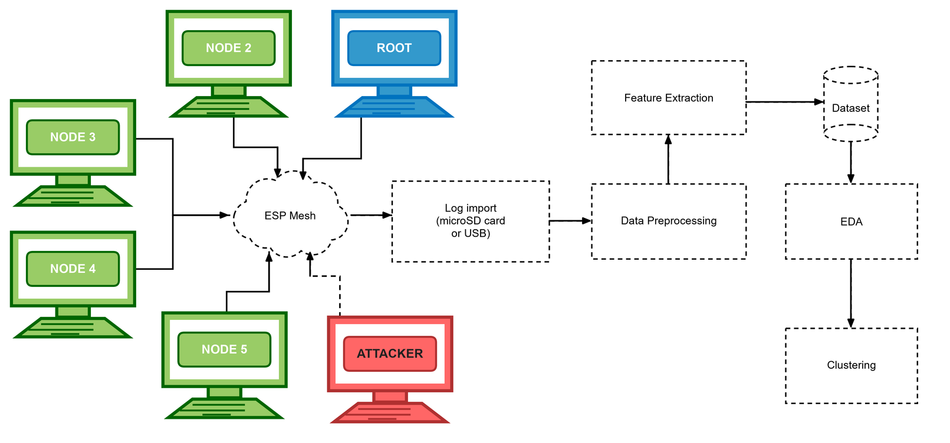
How one run works
Formation
≥ 60 s
Baseline
300 s
Attack
180 s
Cooldown
120 s
→ End
label 255, excluded
label 0 (normal)
label 1 blackhole / 2 wormhole
label 0 (normal)
  Every board logs at 10 Hz to flash and a microSD card
  Logs are imported after the run; nothing is streamed over the mesh, so an attack cannot erase its own evidence
  The root drives the phases: 5 rounds, 100 ms apart, repeated every 10 s
  The attack starts only after the pre-run gates pass and the operator types START (D-22)
  Labels come from the phase schedule, never from a feature
Figure 4.1. Read left to right: boards → ESP mesh → log import → preprocessing → features → dataset → EDA and clustering. Red board = attacker; dashed boxes = processing steps.
NIS16 | Cross-Layer Dataset of an ESP32 ESP-WIFI-MESH Network | Thesis 3
7
Notes:
KEY FACTS
- Phase IDs: 254 formation, 0 baseline, 1 blackhole, 2 wormhole, 3 cooldown, 4 terminate; a run uses phase 1 or 2, never both
- Root = referee: receives every probe, logs every arrival, drives the phases; a session ID tells a restarted root from a repeat
- Probe = tiny app packet: magic, sequence number, send time, source MAC; every 1000 ms (stationary, burst) or 250 ms (highload)
- Gates (D-22): every child joined; tree blackhole attacker has a child; wormhole has one A and one B, UART works, A shallower
- A failed gate locks START (D-24); override needs a typed reason, logged and reported
- Sniffer laptop outside the mesh = independent witness (optional)
IF ASKED
- Why label 255 for formation? Rows outside the experiment can be excluded by value instead of by time
SOURCE: Table 4.1, Figures 4.1 to 4.3, Section 4.1
7

Slide 8
Two attacks, emulated at the application layer
Blackhole: forwarding suppression
Wormhole: out-of-band tunnel
  A placed relay runs the same relay code as every node
  In the attack phase it stops forwarding (no esp_mesh_send() call)
  It still ACKs every frame at the link layer, so victims see no failure
  UART wire, 115200 baud, 30-byte frames with CRC32
  End B (deeper) also writes its own probes into the wire; end A (shallower) re-injects them toward the root
  The root gets every B probe twice, by two paths, with different delays
✓
5 of 6 criteria of Airehrour et al. [70] met
✓
4 of 5 criteria of Hu, Perrig and Johnson [46] met
✗
Not met: attracts traffic with a false route
✗
Not met: creates a false neighbour
Why emulation (D-20): ESP-WIFI-MESH lets an app read its routing table but not write it, so both attacks reproduce the traffic effect, not the routing manipulation.
NIS16 | Cross-Layer Dataset of an ESP32 ESP-WIFI-MESH Network | Thesis 3
8
Notes:
KEY FACTS
- Blackhole: forward_decision() returns false in phase 1; the probe is dropped by omission; the attacker keeps its parent and keeps logging
- The link-layer ACK is why victims never retry or change parent (explains "retransmissions not observed" in Ch 6)
- Traffic reaches the attacker by placement, not a false route; in the star the attacker is the hub (D-16)
- Wormhole frame: "TNL1" magic + the 22-byte probe + CRC32; A changes the magic to "PROW" so the root logs it as a second arrival
- A keeps B's sequence number, timestamp and source MAC; roles set at run time by depth via a HELLO frame and locked at phase 0 (D-17)
- The wire plays the role of the GSM link in Zhukabayeva et al. [71]
- A wormhole run has no victims: only B's own probes are tunnelled; the other 5 boards are untouched
IF ASKED
- "Is it really a blackhole?" Meets 5 of 6 criteria (Table 4.4); we call it forwarding suppression and list route attraction as the first limitation
- "Is it a wormhole if the topology never changes?" Two colluding ends, out-of-band channel, capture and replay (Table 4.5); it reproduces the packet-level signature, not the false neighbour
- "Why not make the root the attacker?" The root is the destination and the referee; it would be grading itself (D-16)
- Weak spot: Table 4.4 row 1 still says victims address the attacker. Since D-12 victims send to their own parent; the tree routes them through the attacker
SOURCE: Sections 4.2.1.2 and 4.2.1.3; Tables 4.4 and 4.5; D-20
8

Slide 9
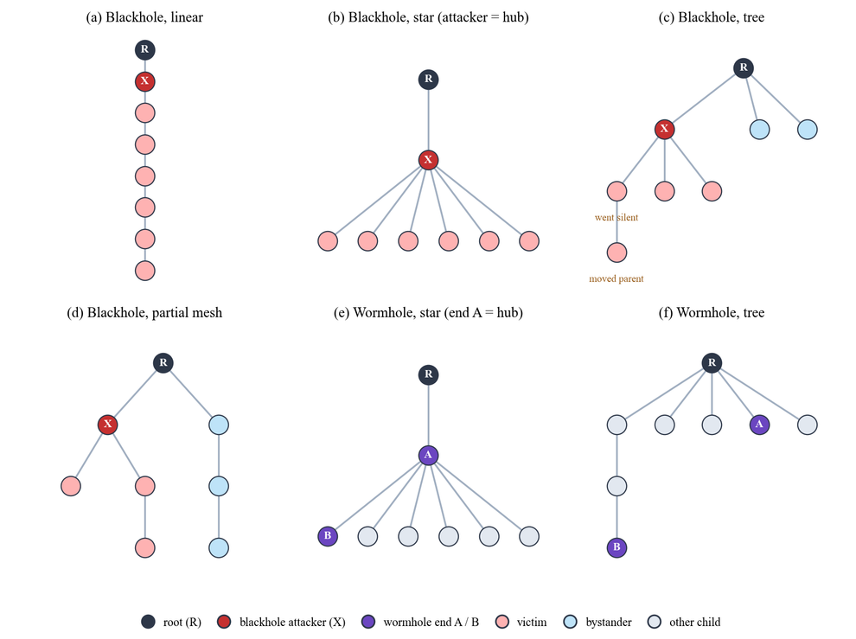
Topologies as they formed, and the run design
Three sites
  G402 (GCCS): controlled classroom
  DLSU Library: busy area, heavy Wi-Fi
  Yuchengco Building: area within the building
Three traffic scenarios
  Stationary: 1 probe per second (reference)
  Burst: 300 probes, 60 s into the attack
  Highload: 4 probes per second, whole run
4 topologies × 2 attacks × 3 sites × 3 scenarios = 72 attack runs
+ 8 benign runs = 80. One run per cell, so the sites act as repeats.
How to read it
Question: What shape did each network really take when the attack started?
How to read: Each drawing is one run's tree: root R on top, each line down is one hop. X = blackhole attacker, A / B = wormhole tunnel ends, pink = victims (behind X), light blue = bystanders, grey = other boards.
What you see: The star has no bystanders, because every board sits behind the hub. In (f), end B sits deeper than end A, so the tunnel skips hops.
NIS16 | Cross-Layer Dataset of an ESP32 ESP-WIFI-MESH Network | Thesis 3
9
Notes:
KEY FACTS
- ESP-WIFI-MESH always builds its own tree; a topology = board placement + an ESP-IDF option (depth cap, children limit); what formed is checked after every run
- Linear: chain, deepest hop 7. Star attack runs: root has 1 child, the hub has 6 (attacker or end A is the hub, D-16, D-28)
- Tree: root has 2 to 5 children, deepest hop 2 to 4 (D-26 sticky parents, D-37 children limit per build)
- Partial mesh: at most 2 children per node; no board ever used a second parent, so it behaved as a branched tree (D-29)
- Star has no bystanders: every board is behind the hub
- Scenarios exist so traffic volume alone cannot reveal an attack
- Hop = layer - 1, root = hop 0 (D-11)
IF ASKED
- "Is your partial mesh really a mesh?" No board used a second parent; reported as a placement-defined branched tree, no adaptive switching claimed
- "Why does the star tunnel skip only 1 hop?" A flat star puts every board at hop 1; A as hub gives the smallest real shortcut (D-28)
- Weak spot: Section 4.2.2.1 still says Figure 4.16 is "to be redrawn" and hub-star "not yet usable". The figure is redrawn and all 9 star wormhole runs are captured and confirmed
- Weak spot: 4.2.2.2 says sticky tree parents "not yet confirmed on hardware"; only 1 of 132 tree boards changed parent in the labelled phases
SOURCE: Section 4.2.2, Table 6.35, Figure 4.57
9

Slide 10
From raw rows to 16 features
1
Align
Boards share no clock; each is aligned to its own exit from phase 0
Forwarding
ForwardingRatio, IngressEgressDelta, ConsistencyScore
2
Window
1 s windows on a 10 Hz grid; fewer than 8 of 10 samples = discarded
Delivery
PDR (blank when nothing was sent), RetryRate
3
Fill
Gaps of 1–2 samples inside a kept window are filled
Topology
ParentSwitchRate, HopChangeCount, HopStabilityDuration
4
Count
Cumulative counters become per-window deltas
Physical
RSSI_mean, RSSI_var, RSSI_stability
Join
Delivery joins root arrivals on the sequence number, never on time
Cross-layer
RSSI_Hop_Diff, LatencyHopRatio
5
Tunnel
TunnelIntensity, TunnelBytes, TunnelLatency (ends only)
One row = one board × one second
NIS16 | Cross-Layer Dataset of an ESP32 ESP-WIFI-MESH Network | Thesis 3
10
Notes:
KEY FACTS
- Grid rule (D-25): each sample takes the earliest free 0.1 s tick, at most 300 ms late, never early
- Result: 457,568 windows formed, 1,372 discarded (0.30%); no run lost more than 1%
- Why 1 s windows of 10 samples (D-1, D-9): with 5 samples one loss costs 20% of a window; the panel asked for about 10,000 rows per run
- Side effect: about one probe per second, so one window's PDR is close to 0 or 1; PDR is read as a mean over many windows
- ForwardingRatio = forwarded / received; ConsistencyScore = |FR - 1|; IngressEgressDelta = |received - forwarded|
- PDR gets a value (even 0) only if the node sent, was attached, and the root was logging (D-8)
- LatencyHopRatio uses delay relative to the sender's fastest delivery (D-2); TunnelLatency = gap between the two copies at the root (D-3), offset cancels exactly
- RetryRate = app counters (failed sends), not MAC retries (D-15); on end B it counts tunnel frames
IF ASKED
- "Clocks aren't synchronised, so how do you get delay or delivery?" Join on sequence number; align each board to its own phase-0 exit; delay is relative (D-2)
- Weak spot: the paper text says IngressEgressDelta and RSSI_Hop_Diff are differences ("minus"); the dataset stores the absolute value of both
SOURCE: Section 4.2.4, Tables 4.17 and 6.7
10

Slide 11
How to read the dataset: one row
One row = one board × one second. Four real rows from the tree / G402 / stationary blackhole run (board = last four hex digits of its MAC):
# | Board | PDR | LatencyHopRatio | Role | When | Label | Hop | Received | Forwarded | Dropped | ForwardingRatio
1 | 1C38 | blank | blank | attacker | baseline, −100 s | 0 | 1 | 3 | 3 | 0 | 1.000
2 | 1C38 | blank | blank | attacker | attack, +120 s | 1 | 1 | 3 | 0 | 3 | 0.000
3 | D7B4 | 0.000 | blank | victim | attack, +120 s | 1 | 2 | 0 | 0 | 0 | blank
4 | 0C80 | 1.000 | 6.161 | bystander | attack, +120 s | 1 | 1 | 0 | 0 | 0 | blank
1
Label = the phase
2
Blank is not zero
3
Same label, different story
Rows 1 and 2 are the same board. The label flips from 0 to 1 only because the schedule entered the attack phase; no feature decided it.
Blank = not defined: ForwardingRatio needs something received, PDR is not scored on the attacker. Row 3's 0.000 is real: probe sent, none arrived.
Rows 3 and 4 both carry label 1, but the victim's PDR is 0.000 and the bystander's 1.000. That is why no method reaches ARI 1.0 on all nodes.
NIS16 | Cross-Layer Dataset of an ESP32 ESP-WIFI-MESH Network | Thesis 3
11
Notes:
KEY FACTS
- Rows come from the windowed feature table of the tree / G402 / stationary blackhole run. Rows 2 to 4 are the same second, 120 s after the attack started; row 1 is 100 s before it. Nothing is typed by hand
- Boards: 1C38 = the blackhole attacker (hop 1); D7B4 = a victim (its parent is the attacker, hop 2); 0C80 = a bystander (its parent is the root, hop 1)
- hop = layer - 1; the root is hop 0
- Received, forwarded and dropped are per-second changes of running counters; on a relay received = forwarded + dropped (row 2: 3 = 0 + 3)
- ForwardingRatio = forwarded / received, blank when nothing was received (rows 3 and 4: received 0)
- PDR is not scored on the attacker or the wormhole ends; elsewhere it gets a value, even 0, only if the board sent in that window, was attached, and the root was logging (D-8)
- LatencyHopRatio is blank when none of the node's probes arrived in the window, because a dropped probe has no delay (row 3)
- The table has more columns (RSSI, parent address, sample counts, counter totals, phase IDs); the legend file next to it explains each one
- Cross-check: for the linear / G402 / stationary run the same table gives 1,077 received and 1 forwarded for the attacker in the attack, as in the paper
IF ASKED
- "Why is a bystander labelled attack?" The label is set by phase for every board of the run (Section 6.1); no feature of a board the attack never reached can show it, which caps the ARI at 0.515
- "Why is PDR blank for the attacker?" It is not scored on the attacker or the tunnel ends; the attacker is measured by ForwardingRatio
SOURCE: Section 4.2.4, Tables 4.17 and 6.7; feature table and its legend in the analysis folder of the run
11

Slide 12
Every run is validated before it counts
Signature
Topology
Testing the verifier itself
1
2
0 of 106
3-sigma test (Zhukabayeva et al. [71]): attack mean ≥ 3 baseline SDs away in the expected direction, change ≥ 0.10
Tree rebuilt from parent addresses; a board changing class during the attack fails the run
false confirmations in a placebo test (second half of the baseline relabelled as attack)
3
Dataset
4
Scenario
0
Every board covers ≥ 95% of each phase; missing boards are graded by role
Probe rate and burst timing match the scenario the run is filed under
verdicts changed when every threshold moved ±50% (53 runs, 14 settings)
An absurd setting (1,000 SDs) changed 18 verdicts, so the test can fail.
Rules fixed before any result was read. Missing data never becomes a pass or a fail.
NIS16 | Cross-Layer Dataset of an ESP32 ESP-WIFI-MESH Network | Thesis 3
12
Notes:
KEY FACTS
- 3-sigma details: 5 one-second windows pooled into one point (36 attack points); also needs at least 6 attack points
- Baseline never varied (SD = 0): any move in the expected direction passes. Broken baseline (mean < 0.90 or SD > 0.15 of mean) = primary excluded, not failed
- Primaries: blackhole = attacker ForwardingRatio + PDR of non-attacker nodes; wormhole = TunnelIntensity (ends count themselves) + DuplicateRate (root's independent view, D-21)
- Setup check: blackhole attacker relayed then dropped, victims alive but cut off; wormhole one A and one B, A shallower, wire delivered B's frames
- Parent changes in the attack tolerated if the board keeps its class (D-23); attacker re-parenting rules D-31; outcome-blind (reads only parent addresses)
- Outcomes: PASS / FAIL / INCONCLUSIVE; grades STRONG, GOOD, MINOR GAPS (kept, footnoted), MAJOR GAPS (recaptured)
- TunnelLatency and LatencyHopRatio are reported, not scored: no tunnel baseline; LatencyHopRatio |z| could never exceed 0.64
IF ASKED
- "How do you know a run is valid and not noise?" Five checks, rules fixed in advance, placebo 0 of 106, sensitivity ±50% changed nothing
- Weak spot: 4.2.7.1 calls a zero-SD z "undefined", 6.2 calls it "infinite". Safe phrasing: the baseline never varied, so any move in the expected direction passes
SOURCE: Section 4.2.7, Figure 4.55, Table 4.24
12

Slide 13
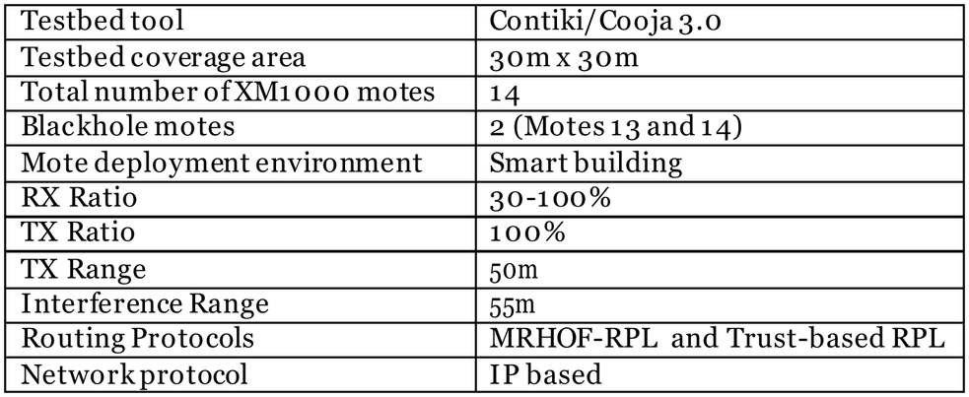
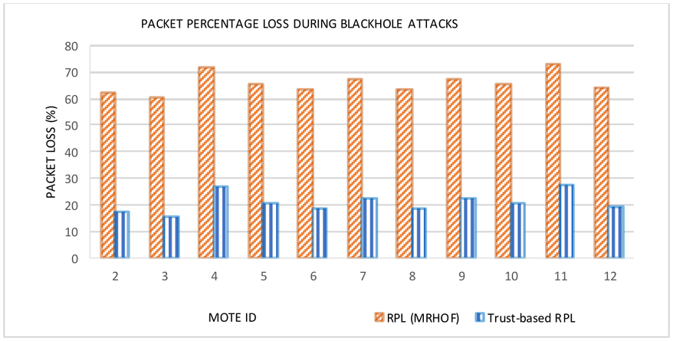
Blackhole reference study: Airehrour et al. [70]
Their study and what we took
Architecture: 14 real AS-XM1000 (Telos-B) motes running RPL (MRHOF) on InstantContiki 3.0, in a 30 m × 30 m research lab (1 sink, 12 senders, 2 blackhole motes); the sink feeds a PC running Contiki/Cooja.
Their attack: the blackhole mote advertises a false good rank, attracts traffic and drops it.
What they measured: packet loss, rank changes and throughput per mote. Loss 60–75% with plain RPL (under 28% with their trust-based RPL); 16 to 246 rank changes.
What we based on it: the blackhole definition we check against (Table 4.4: 5 of 6 criteria met) and the delivery figure we compare with (Table 6.34).
Where we differ: our attacker sits on the path by placement and never advertises a false route (D-20). So delivery behind it drops to 0 (theirs 25–40%), but parents barely change (0.00009 per s vs. 16–246).
Healthy reference: Khan et al. [22], an ESP32 mesh with delivery above 97%, is our baseline comparison.
Their set-up. Adapted from Airehrour et al. [70, Table 2] (paper Table 4.21)
Their result: packet loss per mote. Adapted from [70, Figure 10] (paper Figure 4.48)
NIS16 | Cross-Layer Dataset of an ESP32 ESP-WIFI-MESH Network | Thesis 3
48
Notes:
KEY FACTS
- Airehrour, Gutierrez and Ray (2018), trust-based defence against blackhole and selective forwarding in RPL [70]
- Set-up (their pp. 48-49, Table 2): RPL with the MRHOF objective function, research lab about 30 m x 30 m, 14 AS-XM1000 (Telos-B) motes running InstantContiki 3.0 (1 UDP sink, 12 UDP senders, 2 blackhole motes); their Table 2 lists the testbed tool as Contiki/Cooja 3.0
- Results: loss 60 to 75% under MRHOF-RPL against under 28% with their trust-based RPL; 16 to 246 rank changes per mote against 15 to 55; throughput shown for completeness only (we do not measure kbit/s)
- In [70] loss depends on which motes pick a blackhole mote as parent through routing; ours depends on placement
- What we took: Table 4.4 conformance (6 criteria, 5 met; not met: attracts traffic with a false route); Table 6.34 comparison (delivery direction agrees, size larger here; parent changes differ because of D-20)
- Khan et al. [22]: ESP-MESH campus network, delivery above 97% at every node except outdoor node H; reference for our baseline phase
IF ASKED
- "Was theirs a simulation?" No. 14 real AS-XM1000 motes were deployed in a lab at Auckland University of Technology (their p. 48, photo in Figure 4, p. 49); Contiki/Cooja ran on the desktop PC attached to the sink mote, which is why their Table 2 lists it
- "Why compare with RPL?" No published blackhole measurement on ESP-WIFI-MESH exists; we compare direction and rough size, not equal values
SOURCE: Sections 4.2.7.2 and 4.2.7.6, Table 4.4, Table 4.21, Figure 4.48, Section 6.5.2, Table 6.34

Slide 14
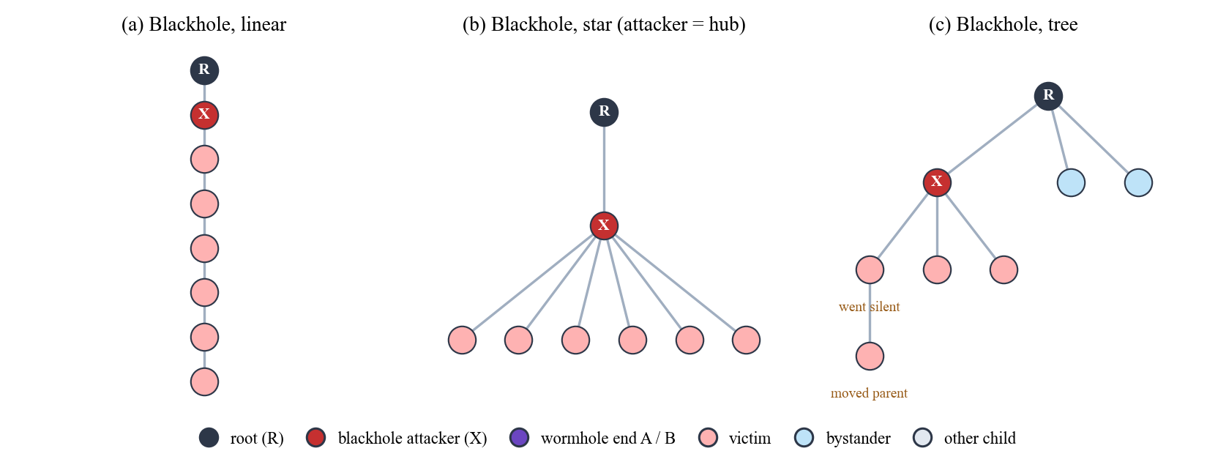
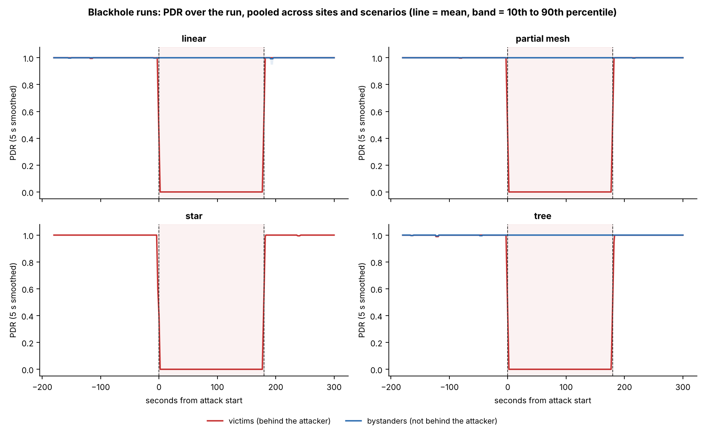
Blackhole measurement: Karlof and Wagner [81]
NEW SLIDE
Their study and what we took
Karlof and Wagner [81]: 2003 survey of attacks on sensor-network routing: selective forwarding, sinkhole, wormhole and others. A blackhole is the extreme case of selective forwarding: a node that forwards nothing.
Why it is hard to see: the attacker accepts each probe at the link layer and then drops it, so the sender sees no failure.
We took: measure the blackhole in two places. At the attacker: its ForwardingRatio, confirmed by its neighbours' counts. At the root: the victims' sequence numbers.
Position decides the victims: the tree, not a configured address, sends traffic through the attacker. Boards behind it are victims; the others are bystanders, our control group.
Verifier rules: a board that changes parent in the attack is tolerated only if it stays a victim or a bystander (D‑23); a missing board is graded by its role (D‑32).
Our result: victims' PDR 0.998 → 0.000 in every blackhole run (all 123 victim boards at exactly 0); bystanders 0.996 → 1.000 (d = 0.09).
Where we differ: our attacker is placed on the path; it does not lure traffic with a false route (D‑20).
Who is a victim depends on where X sits: X = attacker, red = victims (behind X), blue = bystanders. Paper Figure 4.57 (blackhole panels)
Victims (red) lose everything in the attack; bystanders (blue) do not. Paper Figure 6.2
NIS16 | Cross-Layer Dataset of an ESP32 ESP-WIFI-MESH Network | Thesis 3
14
Notes:
KEY FACTS
- Karlof and Wagner (2003), "Secure routing in wireless sensor networks: attacks and countermeasures", Ad Hoc Networks 1(2-3) [81]: the classic survey of routing attacks on sensor networks
- In the paper it backs ONE sentence (4.2.7.1): a blackhole is invisible to its victims, so it is measured at the attacker (ForwardingRatio, confirmed by its neighbours' counts) and at the root (victims' sequence numbers), with the boards outside the attacker's path as a control group
- Victims / bystanders (4.2.1.2): the tree, not a configured address, sends the victims' traffic through the attacker, so the number of victims depends on where the attacker is placed. Star has no bystanders (every child is behind the hub)
- D-23: a parent change in the attack is tolerated if the board keeps its class; the run fails if a board switches between victim and bystander. D-31: attacker's own re-parenting. D-32: missing attacker = recapture; missing victim/bystander = footnote while others remain
- Results (6.2.1, 6.3): victims 0.998 -> 0.000, all 123 victim boards at exactly 0 in the attack; bystanders 0.996 -> 1.000 (d = 0.09); victims' Cohen's d = -29.71
IF ASKED
- "Why do you need bystanders?" They are the control group: same run, same time, same radio, not behind the attacker. Their delivery did not change, so the loss is the attack, not the room
- "Is your attacker a real blackhole?" It meets 5 of 6 criteria of Table 4.4; it does not advertise a false route (D-20, Espressif docs give no way to write routes)
- Check before quoting: the original [81] was not opened. In it, a blackhole is the simplest form of selective forwarding (a node that refuses to forward every packet), and the attack works best when the attacker is on the data path. Read their selective-forwarding section before quoting it word for word
SOURCE: Sections 4.2.1.2, 4.2.7.1, 6.2.1, Figures 4.57 and 6.2

Slide 15
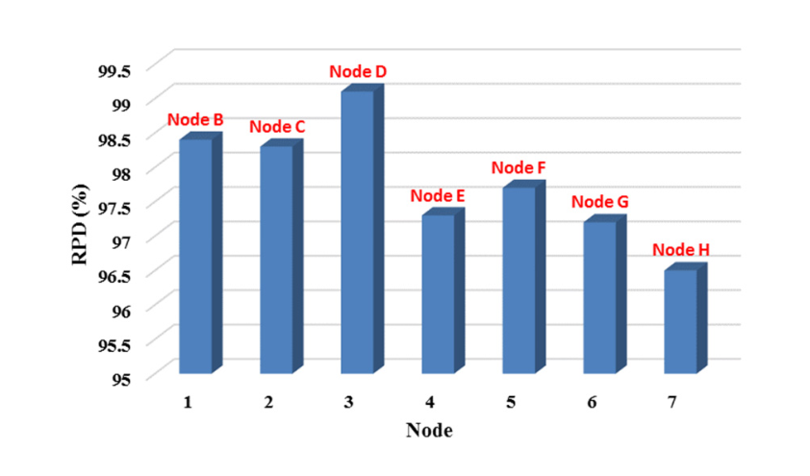
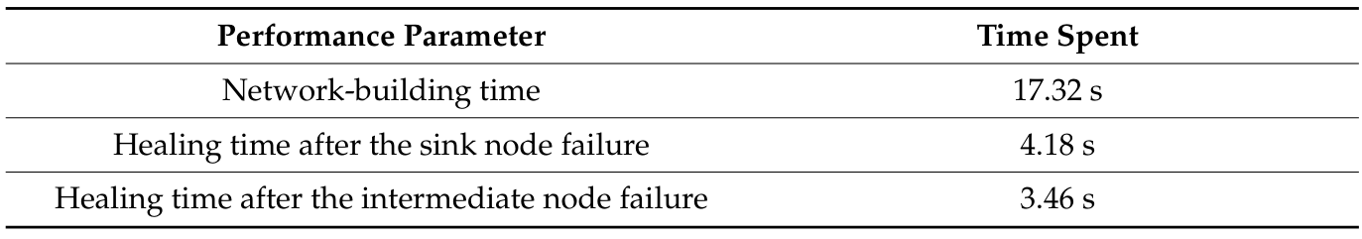
Healthy baseline: Khan et al. [22]
NEW SLIDE
Their study and what we took
Khan et al. [22]: ESP-MESH on ESP32 boards, the same protocol and board family as ours: 7 sensor nodes and a root on a 100 m × 80 m college campus (air-quality monitoring), one 64-byte package every 2 minutes for five days.
Their result: delivery above 97% at every node except node H (outdoor, 100 m from the root); loss and fault rate under 1.8%. The mesh built itself in 17.32 s and healed in 3.46 to 4.18 s after a node failure.
We took: the reference for a healthy baseline phase: before the attack, an ESP-MESH should deliver almost every packet (4.2.7.2).
Our result: baseline PDR 0.998 (victims) and 0.996 (bystanders); benign runs 0.9994 to 1.0000 in both phases. Healthy, like theirs (Table 6.34).
Verifier rules: a primary with a broken baseline (mean below 0.90, or SD above 0.15 of the mean) is excluded, not failed; a benign run needs PDR of at least 0.90 in both phases. The 0.90 bound is ours, not Khan's.
Where we differ: they sent one package every 2 minutes for days; we send about one probe per second in an 11-minute run. We claim both are healthy, not equal.
Khan et al.: delivery per node (RPD, %). Adapted from [22, Figure 20a] (paper Figure 4.51)
Khan et al.: build and healing times. Adapted from [22, Table 6] (paper Table 4.22)
NIS16 | Cross-Layer Dataset of an ESP32 ESP-WIFI-MESH Network | Thesis 3
15
Notes:
KEY FACTS
- Khan et al. (2022), Sustainability 14(24):16630 [22]; local PDF in Resources/ (their p. 18 for every number here)
- Campus test: 7 sensor nodes + root (8 boards), 100 m x 80 m college campus, a 64-byte package every 2 minutes for five days; RPD above 97% except node H (100 m from the root, across more than four buildings, outdoor); PER and PLR under 1.8% except node H
- Open-area stability test (their pp. 15-16): one package per minute for five days, RPD above 98% at every node
- Their Table 6: network building 17.32 s; healing after sink failure 4.18 s, after intermediate-node failure 3.46 s
- Ours: victims' baseline 0.998, bystanders' 0.996, benign runs 0.9994 to 1.0000 in both phases (Table 6.34 row: 'agree in size; counting differs')
- Verifier floors: broken baseline = mean below 0.90 or SD above 0.15 of the mean (primary excluded, not failed); benign confirmed only with PDR of at least 0.90 in both phases and every relay forwarding at least 90%. These are our engineering bounds, set before the results were read
IF ASKED
- "Why compare with a study that had no attack?" It is the only published ESP-MESH delivery figure on ESP32 hardware, so it tells us what a normal phase should look like
- "Your PDR is higher than theirs, why?" Different counting: they count packages over days at up to 100 m outdoors; we count per one-second window over 11 minutes indoors
- Weak spot: paper 4.2.7.6 says their delivery figures come from 'a stability test that sent every 60 s'. The 97% / node H numbers are from the campus test (every 2 minutes); the 60 s test gave above 98%. Safe phrasing: 'their five-day campus test'
SOURCE: Sections 4.2.7.2, 4.2.7.6, Table 6.34, Figure 4.51, Table 4.22

Slide 16
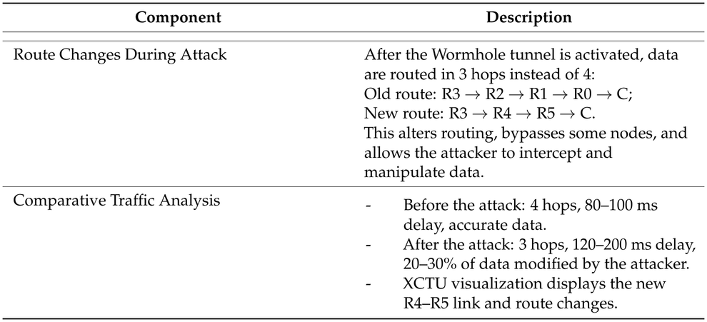
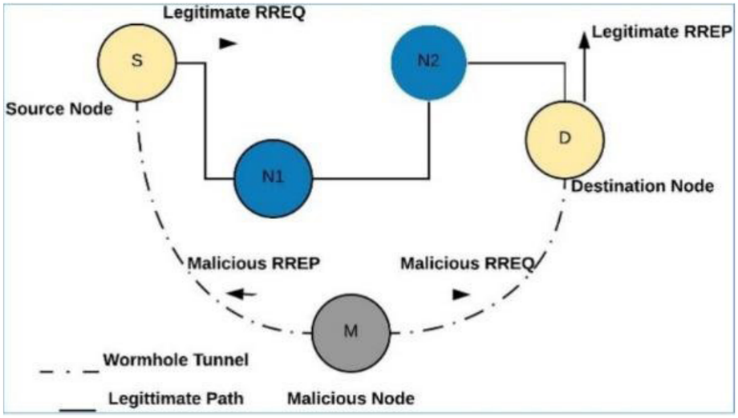
Wormhole reference studies [71] and [72]
Their studies and what we took
Zhukabayeva [71]: ZigBee (XBee) chain of Arduino sensor nodes; the tunnel is two Raspberry Pi nodes joined by GSM and a TCP/IP link. Measured hop count (4 → 3), delay (80–100 → 120–200 ms) and modified data (20–30%).
We took: the 3-sigma rule of our verifier (pooling 5 one-second windows per point is our own step), and the out-of-band tunnel idea, built here as a UART wire.
Ramírez Gómez [72]: XBee S2C with source routing, 1 coordinator and 2 routers; the malicious node is a Raspberry Pi 3 with a USB radio dongle. Results are qualitative; they propose duplicated routing packets as a wormhole signature.
We took: duplicates as the signature, measured at the root as DuplicateRate (D-21).
Definition: Hu, Perrig and Johnson [46]; 4 of 5 criteria met (Table 4.5).
Where we differ: their route got shorter; ours keeps its routes (D-20), so hop count and parents do not change.
Zhukabayeva et al.: route and traffic change. Adapted from [71, Table 7] (paper Table 4.23)
Ramírez Gómez et al.: wormhole with a malicious node. Adapted from [72, Figure 2] (paper Figure 4.54)
NIS16 | Cross-Layer Dataset of an ESP32 ESP-WIFI-MESH Network | Thesis 3
48
Notes:
KEY FACTS
- Zhukabayeva et al. (2025), real-time detection of wormhole and sinkhole attacks in WSNs [71]: ZigBee chain of Arduino-based sensor nodes with XBee modules; wormhole = two Raspberry Pi nodes joined by a GSM link and a TCP/IP tunnel that forwards the ZigBee packets, so the two look like direct neighbours
- Their results: route of 4 hops becomes 3 (R3 -> R2 -> R1 -> R0 -> C becomes R3 -> R4 -> R5 -> C); delay 80 to 100 ms rises to 120 to 200 ms (abstract: about 40% more); 20 to 30% of data modified (abstract: false readings in over 30%); the source is not fully consistent on these numbers
- Ramírez Gómez, Vargas Montoya and León Henao (2019) [72]: classic and reverse wormhole on XBee S2C nodes using source routing; malicious node = Raspberry Pi 3 + USB dongle running KillerBee; two small networks (1 coordinator + 2 routers); no delivery, loss or delay figures
- Their proposed signature: two source-routing packets for each data packet. Related to, but not the same as, our duplicate data arrivals
- What we took: the verifier's 3-sigma rule from [71] (their pp. 14-15; Table 4.20). Pooling 5 one-second windows into one point is OUR design, not theirs; DuplicateRate measured at the root following [72] (D-21); definition and conformance from Hu, Perrig and Johnson [46] (4 of 5; not met: creates a false neighbour)
- Our tunnel: UART wire, 115200 baud, 30-byte frames with CRC32 (Zhukabayeva's was GSM/GPRS), so delay changes are not expected to match
IF ASKED
- "Each attack has a different study; why?" No single published study runs both attacks on ESP-WIFI-MESH; blackhole is compared with [70], wormhole with [71] and [72], the healthy baseline with Khan et al. [22]
SOURCE: Sections 4.2.7, 4.2.7.2 and 4.2.7.6, Tables 4.5, 4.20 and 4.23, Figures 4.52 to 4.54, Section 6.5.2, Table 6.34

Slide 17
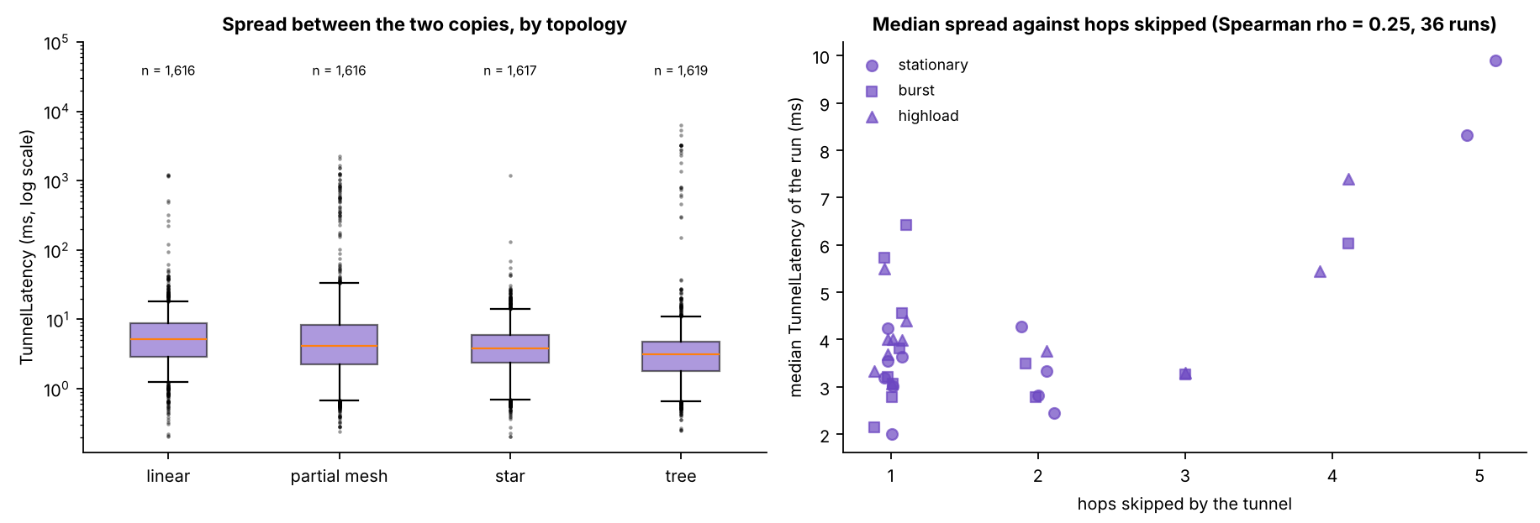
Wormhole definition: Hu, Perrig and Johnson [46]
NEW SLIDE
Criterion | Met | Evidence
Two colluding endpoints | Yes | Node A (exit) and Node B (entry)
Out-of-band channel outside the normal path | Yes | Physical UART link between the two boards
Packets captured at one end and replayed at the other | Yes | 181 of 181 probes from Node B arrived twice in the attack phase, none in baseline or cooldown (linear, DLSU Library, stationary)
No compromise of keys or hosts | Yes | Application layer only, no key material touched
Creates a false neighbour relationship | No | No parent switches or layer changes during the wormhole phase
Their study and what we took
Hu, Perrig and Johnson [46]: the classic wormhole paper (IEEE INFOCOM 2003), which also proposed packet leashes as a defence. Two colluding nodes share a low-latency out-of-band channel; a packet recorded at one place is tunnelled and replayed at another, so distant nodes look like neighbours.
We took: the wormhole definition (3.3.2) and a criterion-by-criterion check against it (Table 4.5, left): 4 of 5 met.
Not met: creates a false neighbour relationship. No parent or layer changed in the attack, so the method is called wormhole-inspired (D‑20).
Timing mismatch: each tunnelled probe reaches the root twice, by the mesh and by the wire, at different times. The gap (TunnelLatency): median 3.9 ms, 90th percentile 12.1 ms over 6,468 windows.
Verifier rule: TunnelLatency is reported, not scored: the baseline has no tunnel, so no 3-sigma test is possible. The verdict rests on TunnelIntensity and DuplicateRate (D‑21).
Where we differ: packet leashes are a defence that bounds how far a packet may travel; we build no defence, we only measure the gap.
Our wormhole against the definition of [46]. Paper Table 4.5
Gap between the two copies of a probe (TunnelLatency), by topology and by hops skipped. Paper Figure 6.6
NIS16 | Cross-Layer Dataset of an ESP32 ESP-WIFI-MESH Network | Thesis 3
17
Notes:
KEY FACTS
- Hu, Perrig and Johnson (2003), "Packet leashes: a defense against wormhole attacks in wireless networks", IEEE INFOCOM 2003 [46]
- Definition used (3.3.2): two colluding nodes, a low-latency out-of-band channel, a packet recorded at one location, tunnelled and replayed at another, so distant nodes look like neighbours
- Table 4.5: 4 of 5 met; the "4 of 5" is OUR count, not a claim of [46]. Not met: false neighbour relationship (no parent switch, no layer change)
- Across all 36 wormhole runs: 12,448 of 12,465 (99.86%) of Node B's probes reached the root twice, 0 in baseline; the tunnel skipped 1 to 5 hops
- TunnelLatency (6.2.2): median 3.9 ms, 90th percentile 12.1 ms, 99th percentile 417 ms over 6,468 windows; run medians 2.0 to 9.9 ms; Spearman rho with hops skipped = 0.25. Measured, not scored (no tunnel in the baseline = no spread)
- The verifier's printed source list says [46] backs "the wormhole timing mismatch"; in the paper [46] backs the definition and Table 4.5, and the gap is reported descriptively
IF ASKED
- "Then why call it a wormhole?" Four of the five defining criteria hold, and the packet-level effect, the same packet arriving by a second path at a different time, is real and measured. We call it wormhole-inspired and list the missing criterion ourselves
- "Could packet leashes catch your tunnel?" Not tested; we built no defence. The gap we measure is the kind of timing evidence a temporal leash looks for
- Not checked against the original: no copy of [46] could be opened (IEEE paywall); a search excerpt confirms the record-tunnel-replay definition. Get it through the DLSU library before the defense
SOURCE: Sections 3.3.2, 4.2.7.1, 6.2.2, Table 4.5, Figure 6.6

Slide 18
The 3-sigma test, in one picture
Schematic of one feature (for example ForwardingRatio) over one run, not to scale
A primary check passes when all three hold
normal range: baseline mean ± 3 SD
The attack mean is at least 3 baseline SDs from the baseline mean, in the expected direction
1
2
The absolute change is at least 0.10
Baseline: 60 points of 5 windows
≥ 3 SD away and a change of ≥ 0.10
3
There are at least 6 attack points
Example (illustrative numbers)
z = (0.003 − 1.000) ÷ 0.002 = −498.5
All three rules met. If the baseline never varies (SD = 0), any move in the expected direction passes.
Attack: 36 points, all far outside the band
NIS16 | Cross-Layer Dataset of an ESP32 ESP-WIFI-MESH Network | Thesis 3
13
Notes:
KEY FACTS
- The 3-sigma rule comes from Zhukabayeva et al. [71] (their pp. 14-15). Pooling every 5 one-second windows into one point is our own step, not theirs: a 180 s attack gives 36 points, the 300 s baseline gives 60
- z = (attack mean - baseline mean) / baseline SD
- A primary with a broken baseline (mean below 0.90 or SD above 0.15 of the mean) is excluded, not failed
- Blackhole primaries: attacker ForwardingRatio and PDR of the non-attacker nodes. Wormhole primaries: TunnelIntensity (counted by the ends) and DuplicateRate (measured at the root, independent of the attackers, D-21)
- Real runs: where z was finite (21 blackhole runs) the attacker's ForwardingRatio sat at least 22.9 SDs away, median 111; in the other 15 runs the baseline never varied
- TunnelLatency and LatencyHopRatio are reported, not scored: the first has no baseline (no tunnel then), the second's baseline is so spread that |z| could never exceed 0.64
- The example numbers are illustrative, not from one run
IF ASKED
- "With SD = 0, is any tiny change a pass?" No: the absolute change must also be at least 0.10, so one lost probe can never count as an attack
- Weak spot: Section 4.2.7.1 calls a zero-SD z "undefined", Section 6.2 calls it "infinite". Safe phrasing: the baseline never varied, so any move in the expected direction passes
SOURCE: Section 4.2.7.1, Section 6.2.1, Table 6.9
13

Slide 19
Chapter 5: 37 deviations, three reasons
37
The platform could not measure it
1
No MAC retry count reaches the app (D-15); probes get no reply, so no round-trip time (D-2, D-3)
documented deviations, D-1 to D-37
2
The plan would leak the label or fail to make the attack
17 modify what the proposal specified; 20 add a rule the proposal did not have. Each lists what was planned, what changed, why, and the cost (Appendix C).
Relay counters existed only on the attacker (D-12); ends at the same depth skip no hop (D-17, D-28, D-30)
3
A run needed rules to be one valid experiment
Pre-run gates and START (D-22); parent changes in the attack (D-23); missing boards by role (D-32)
NIS16 | Cross-Layer Dataset of an ESP32 ESP-WIFI-MESH Network | Thesis 3
14
Notes:
KEY FACTS
- Changes were not planned in advance: each came when a capture or review showed the plan could not be followed or would give untrustworthy data
- Five groups (Table 5.1): data collection and sampling; feature definitions; attack implementation; experimental design; run control and validation
- Several were scope decisions checked with the adviser (D-19 sites, D-33 jitter out, D-35 benign plan)
IF ASKED
- "37 deviations means you didn't follow your proposal?" Each was forced by evidence (three reasons above), each is documented with its cost, and only four limit how the results are read (next slide)
SOURCE: Sections 5.1 and 5.2, Tables 5.1 and 5.2, Appendix C
14

Slide 20
Planned vs. actual: the changes that matter
The proposal planned | What we did | Why
Attacks on routing (false route, false shortcut) | App-layer emulation: a placed relay drops; a wire copies probes | The API reads routes but cannot write them (D-20)
The mesh stack relays traffic out of sight | Every node relays probes itself and counts them | Only the attacker had relay counters, which leaked the label (D-12)
MAC retry count from Wi-Fi statistics | App counters kept as a column; real retries from a sniffer (7 runs) | No retry number reaches the app (D-15)
5 s windows of 5 samples | 1 s windows of 10 samples at 10 Hz | One lost sample cost 20% of a window (D-1, D-9)
Flat star; fixed wormhole ends | Hub = attacker or end A; ends chosen by depth, B deeper | Root cannot attack; equal depth skips no hop (D-16, D-17, D-28, D-30)
No benign control runs | 8 benign runs across sites and scenarios | A control for false alarms (D-18, D-35)
Limits how Chapter 6 is read (5.7): D-20 emulation, D-15 no MAC retry count, D-18/D-35 only 8 benign runs, D-37 tree fan-out differs per run.
NIS16 | Cross-Layer Dataset of an ESP32 ESP-WIFI-MESH Network | Thesis 3
15
Notes:
KEY FACTS
- D-20 is the most important limitation: no route attraction, no false neighbours, no attacker-caused parent changes in the data; this is why cross-layer features stayed flat
- D-12 answered the Thesis 2 panel objection "if one feature decides it, ML is unnecessary": before it, an empty relay column identified the attacker
- D-15: the only statistics call prints to the log and returns a status; no number reaches the app
- D-5: baseline = phase 0 of the same run, so firmware, roles and placement are identical and the attack is the only change
- Benign plan went 12 -> 9 (jitter dropped, D-33) -> 12 -> 8 (D-35); final 4 stationary, 3 highload, 1 burst; G402 4, Library 2, Yuchengco 2
- Star wormhole (D-28): normal copy B -> A -> root = 2 hops; tunnel copy = 1 hop; A also relays B's normal copy, controls are 2 hops from the root
- D-36: in tree and partial mesh the wormhole ends join as leaves; D-30: B never takes the root as parent
SOURCE: Sections 5.3 to 5.7
15

Slide 21
Chapter 6: Results and Discussion
6
The dataset, attack validation, EDA, clustering and what it all means
16
Notes:
16

Slide 22
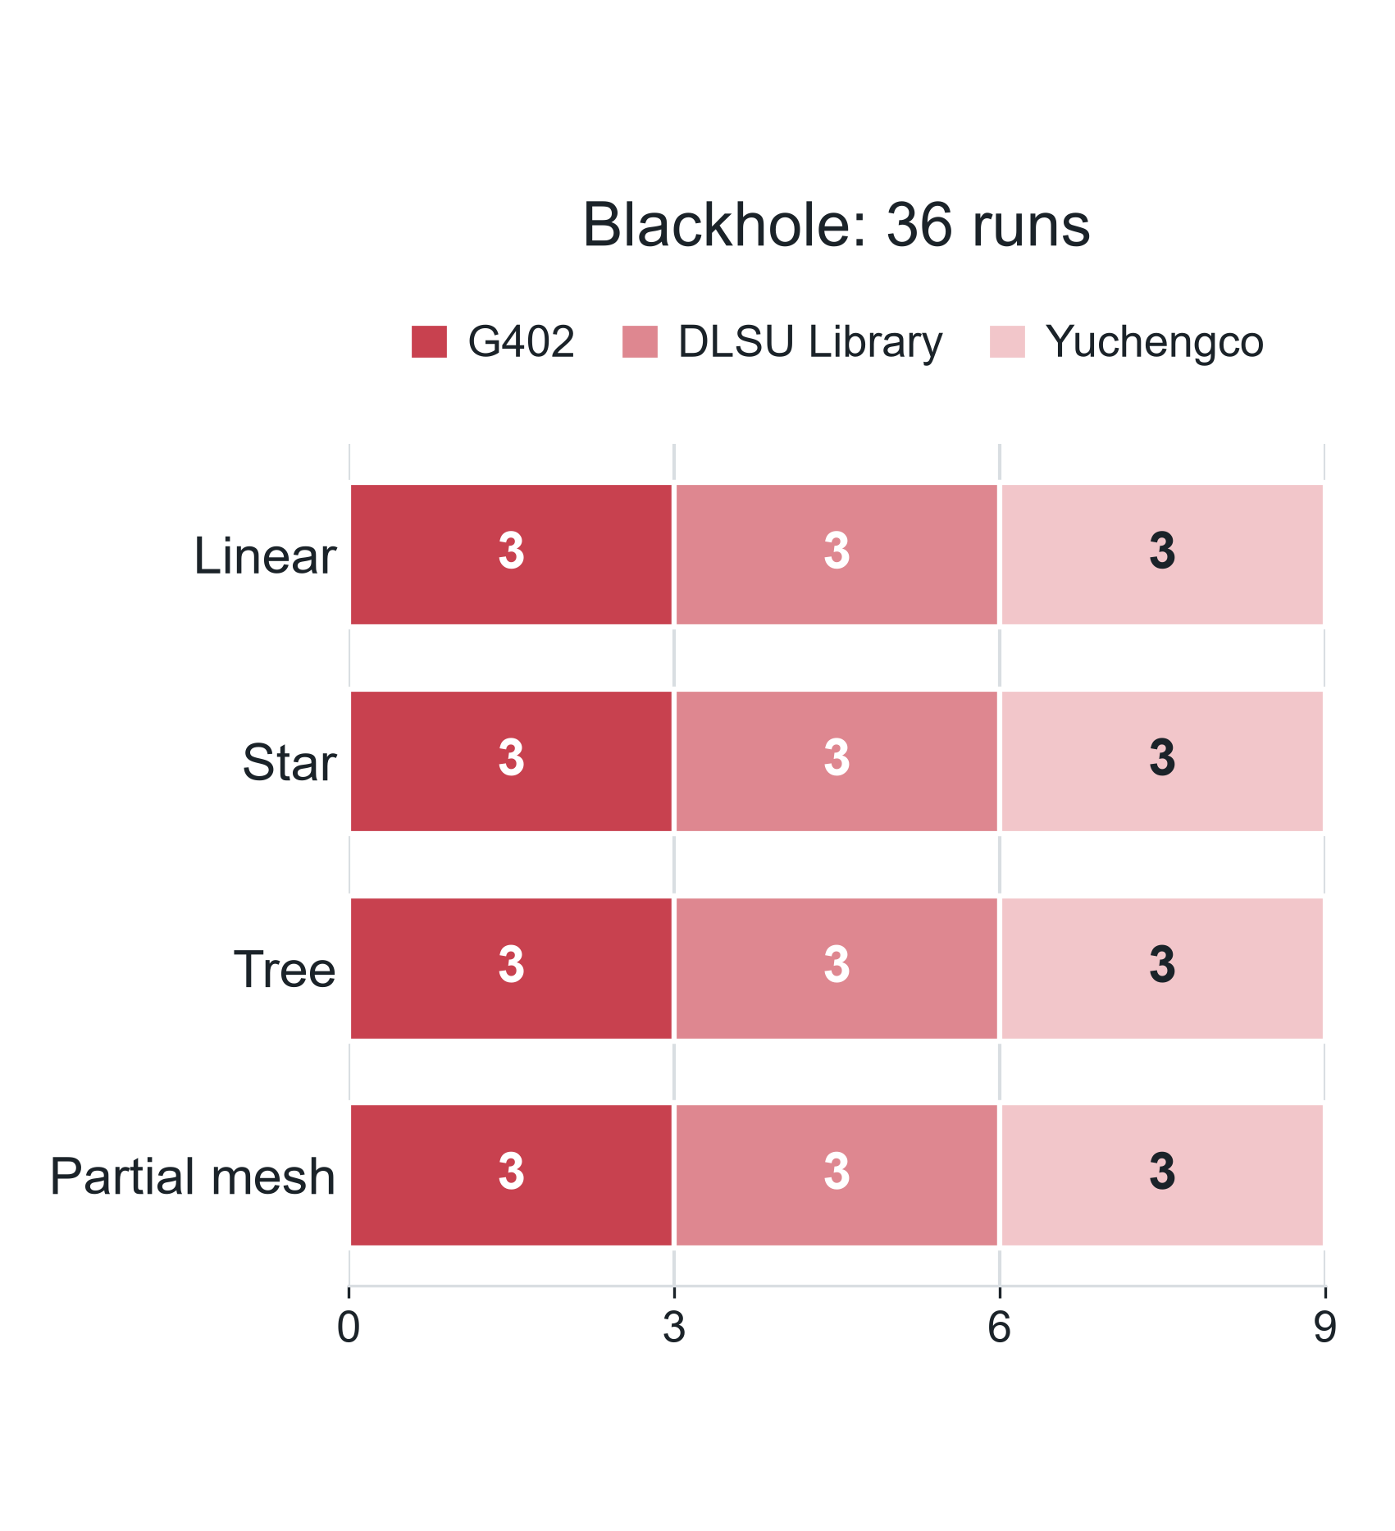
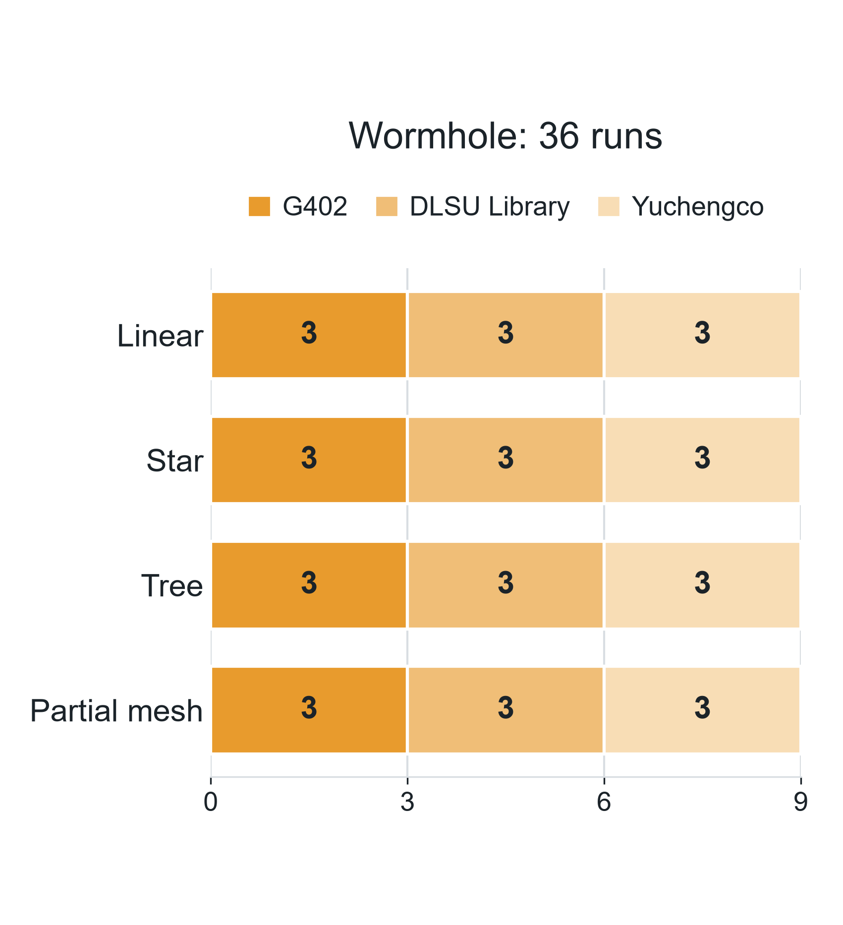
The dataset: 80 of 80 runs captured
80 / 80
runs: 36 blackhole, 36 wormhole, 8 benign
369,678
windows analysed (of 456,195)
0.30%
windows discarded (1,372)
637
log files, none empty
Benign (no attack): 8 runs. Linear 3, star 3, tree 1, partial mesh 1. Each one shares its topology, site and scenario with an attack run.
Analysed: 266,491 normal + 103,187 attack windows. Blackhole boards: 123 victims, 92 bystanders (the star has none).
How to read it
Question: How many runs did we capture for each attack?
How to read: Left = blackhole, right = wormhole. One bar per topology, split by site (shades). Each part = 3 runs, one per traffic scenario (stationary, burst, highload).
What you see: Both attacks have the same full grid: 4 topologies × 3 sites × 3 scenarios = 36 runs each. With the 8 benign runs, 80 in total.
NIS16 | Cross-Layer Dataset of an ESP32 ESP-WIFI-MESH Network | Thesis 3
17
Notes:
KEY FACTS
- By site: G402 28, Library 26, Yuchengco 26 runs
- Every run has 8 boards except benign star/Yuchengco/highload (6) and blackhole tree/G402/highload (7: B768 recorded nothing, a bystander)
- Window shares (Table 6.2): before baseline 85,435 (not analysed); baseline 190,423; attack 103,187; cooldown 76,068; phase boundary 1,082
- 15 earlier captures of 11 cells replaced and archived; 12 captures outside the plan (5 jitter, 7 at home) not counted
- 7 groups carry a note but are kept: e.g. linear/G402/burst blackhole burst fired outside the attack (D-34, minor gap); all 9 partial mesh runs per attack are plain trees
- Why features are often blank (Table 6.8): ForwardingRatio exists only when a node relayed something (36.3% of non-attacker windows); PDR is not scored on the attacker or tunnel ends
IF ASKED
- Weak spot: 457,568 formed minus 1,372 discarded = 456,196, but Table 6.2 totals 456,195. A one-window bookkeeping difference, not yet traced; changes no percentage or result
- Weak spot: the Chapter 4 intro still says "while the remaining runs are captured"; all 80 were captured
SOURCE: Section 6.1, Tables 6.1 to 6.8
17

Slide 23
Blackhole results
6A
Did the attack work, what it changed, and whether clustering finds it
16

Slide 24
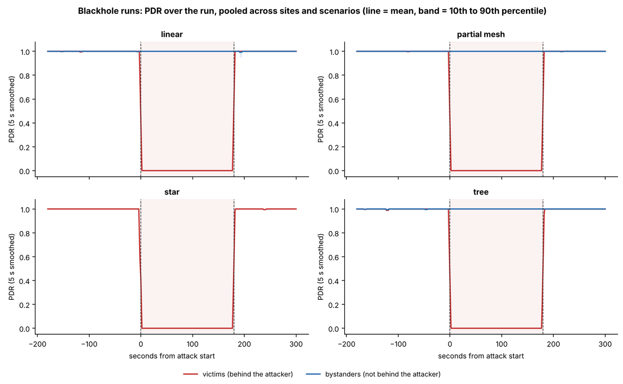
Blackhole: confirmed in all 36 runs
36 / 36
blackhole runs confirmed (4 strong, 27 good, 5 minor gaps)
  Attacker ForwardingRatio: 1.000–1.004 → 0.000–0.007
  Victim PDR: 0.998 → 0.000; every one of the 123 victims averaged exactly 0
  121 of 123 victims cut off in the first second; recovery median 2 s
  Bystanders: 0.996 → 1.000
How to read it
Question: Did the victims lose delivery during the blackhole, and only then?
How to read: Time runs left to right (0 = attack starts, 180 = attack ends, shaded). Height = PDR, the share of probes that reached the root (1 = all). Red = victims, blue = bystanders.
What you see: Red falls from 1 to 0 the moment the attack starts and comes back right after it ends. Blue stays at 1. The star has no blue line (no bystanders).
NIS16 | Cross-Layer Dataset of an ESP32 ESP-WIFI-MESH Network | Thesis 3
18
Notes:
KEY FACTS
- Table 6.9: attacker ForwardingRatio primary passed 36 of 36; PDR primary 35 of 36 (one excluded: unstable baseline 0.930 ± 0.253, partial/Yuchengco/stationary)
- Support checks: ConsistencyScore 31/36, IngressEgressDelta 31/36, NeighbourForwardingRatio 32/36 (4 runs had no attack values; none failed)
- Where z was finite (21 runs) the attacker's ForwardingRatio sat at least 22.9 SDs away, median 111; in 15 runs the baseline never varied
- Example run, G402 linear stationary: attacker received 1,077 probes in the attack and forwarded 1 (ForwardingRatio ≈ 0.001)
- The other 2 victims fell below 0.5 within 1 s; recovery within 3 s for 122 boards (one went silent)
- Figure 6.1: every cell of the 36-run grid shows victim attack PDR 0.00
SOURCE: Section 6.2.1, Table 6.9, Figures 6.1 to 6.3
18

Slide 25
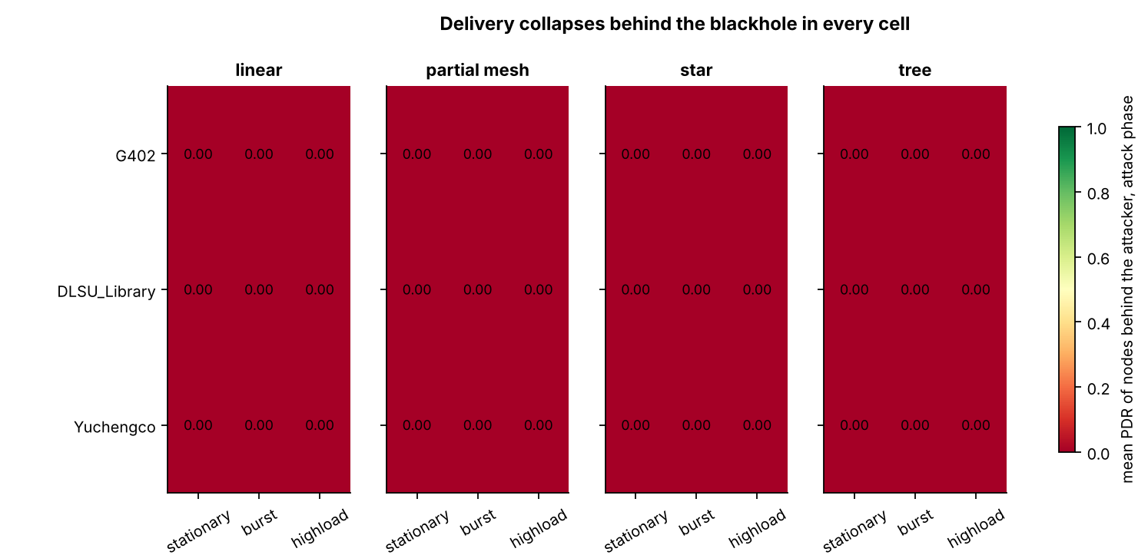
Figure 6.1: delivery collapses in every blackhole run
How to read it
Question: Did the blackhole cut off the victims in every single run?
How to read: Each tile = one run (panel = topology, row = site, column = scenario). Colour and number = the victims' average PDR during the attack: green = 1 (all delivered), dark red = 0 (nothing).
What you see: All 36 tiles are dark red at 0.00: in no run did a victim's probe reach the root during the attack.
NIS16 | Cross-Layer Dataset of an ESP32 ESP-WIFI-MESH Network | Thesis 3
43
Notes:
KEY FACTS
- Every one of the 123 victims has an attack-phase mean PDR of exactly 0
- 36 runs = 4 topologies x 3 sites x 3 scenarios
SOURCE: Section 6.2.1, Figure 6.1
43

Slide 26
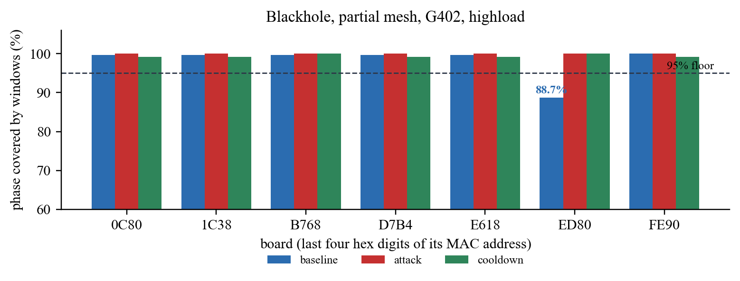
Figure 4.58: dataset check, one run
How to read it
Question: Did every board record enough of each phase?
How to read: One group of bars per board (last four hex digits of its MAC). Height = % of the phase it recorded. Blue = baseline, red = attack, green = cooldown. Dashed line = the 95% minimum.
What you see: Every bar clears 95% except board ED80's baseline (88.7%). That is a minor gap, so the run is kept with a footnote.
NIS16 | Cross-Layer Dataset of an ESP32 ESP-WIFI-MESH Network | Thesis 3
42
Notes:
KEY FACTS
- Run shown: blackhole, partial mesh, G402, highload
- Board ED80 covered 266 of 300 s of baseline (88.7%)
- The impact check reran the test without ED80; the attack was still confirmed, so the run is kept with a minor gap
- Missing boards are graded by role (D-32): attacker or tunnel end = major; victim or bystander = minor while others of that role remain
SOURCE: Section 4.2.7.3, Figure 4.58
42

Slide 27
Blackhole predictions: delivery yes, retransmissions no
Prediction (Table 3.4) | Observed? | Measured
Attacker: ForwardingRatio < 1 | Yes | 1.000–1.004 → 0.000–0.007; passed 36 of 36 runs
Attacker: Ingress/Egress Delta > 0 | Yes | Passed 31 of 36; the other 5 rose but stayed under 3 SD
Victims: PDR falls | Yes | 0.998 → 0.000; all 123 victims averaged exactly 0
Victims retransmit more (MAC) | No | App counter 0.0000 → 0.0004; sniffer (7 runs): 3 up, 4 down
Attacker: RSSI stays stable (PHY) † | Yes | −67.1 → −67.8 dBm; within 1 dB in 27 of 36 runs
† Not reported in the paper: computed from the same feature tables (attacker windows, baseline vs. attack). Table 3.4 rows 1 to 4: Tables 6.9 and 6.10, Section 6.2.4.
The attacker's counters and the victims' delivery moved; the radio never saw a failure, because the attacker still acknowledges every frame.
NIS16 | Cross-Layer Dataset of an ESP32 ESP-WIFI-MESH Network | Thesis 3
22
Notes:
KEY FACTS
- Table 3.4 has 5 blackhole predictions: ForwardingRatio, Ingress/Egress Delta, PDR, retransmissions, RSSI at the attacker
- ForwardingRatio and PDR are the two primary checks of the verifier (Table 6.9): 36 of 36 and 35 of 36 (one run excluded for an unstable baseline, 0.930 ± 0.253)
- Ingress/Egress Delta is a support check: 31 of 36; the 5 misses have z between 0.4 and 2.9 (they rose, but less than 3 SD)
- PDR: 121 of 123 victims cut off in the first second; recovery median 2 s (Table 6.10)
- Retransmissions: the attacker still ACKs every frame at the link layer, so a victim's radio sees no failure; app-counter failed sends in only 9 of 21,742 victim attack windows
- Sniffer (real 802.11 Retry bit), 7 runs: victims 0.295 -> 0.364 -> 0.323, but the sign differs between runs; 7 runs are too few to rule out a small effect
- Victim ParentSwitchRate 0.00000 -> 0.00009 (d = 0.01)
RSSI ROW (not in the paper)
- Attacker RSSI_mean, mean over the 36 runs: -67.1 dBm baseline, -67.8 dBm attack; |change| <= 1 dB in 27 of 36 runs; beyond 3 baseline SDs in 1 run (linear / DLSU Library / highload, -5.7 dB)
- Computed from the attacker rows of the 36 feature tables; the paper text has no number for this row. Say so if asked, or add one sentence to Section 6.2.4
IF ASKED
- "Where is the MAC layer in your cross-layer dataset?" No MAC retry count in ESP-IDF (D-15); sniffer Retry bit in 7 runs showed no consistent rise; the MAC side rests on RSSI and link/parent state
SOURCE: Table 3.4; Section 6.2.1, Tables 6.9 and 6.10; Section 6.2.4
22

Slide 28
Clustering: how the data were asked to sort themselves
5
Algorithms
3
Feature sets
4
Scores
  K-Means
  Ward (hierarchical)
  GMM (Gaussian mixture)
  DBSCAN (eps at the k-distance knee)
  Spectral
  FULL: 8 features allowed by the leakage guard
  REDUCED: PDR, RSSI_mean, RSSI_var, RSSI_Hop_Diff
  Without PDR: the 3 RSSI features, as a control
  Silhouette, Davies–Bouldin: cluster shape, no labels
  Purity, ARI: agreement with the label, computed only afterwards
  ARI: 1 = exact, 0 = chance
6,000 sampled windows per seed (42, 7, 123), standardised features, k = 2 to 8. The algorithm never sees the label.
NIS16 | Cross-Layer Dataset of an ESP32 ESP-WIFI-MESH Network | Thesis 3
26
Notes:
KEY FACTS
- Clustering groups windows only by how similar their features are; the label is used afterwards to score the groups
- Why 16 features become 8: relay features, RetryRate and tunnel features are blocked by the leakage guard; LatencyHopRatio's missingness predicts the label in 86% of windows
- REDUCED = FULL after the low-variance filter (drop if > 90% of windows share one value) and the correlation filter (|r| > 0.85, removed nothing; largest |r| 0.11)
- Removed by low variance: ParentSwitchRate (100% one value), HopChangeCount (100%), HopStabilityDuration (99.8%), RSSI_stability (98.5%)
- Two populations: all non-attacker nodes (127,372 windows) and victims only (72,687)
- DBSCAN min_samples between D+1 and 2D; eps at the knee (0.79, 0.73, 0.56); best-silhouette setting kept
- Purity trap: purity 0.702 = the majority rate = no separation; always read purity against it
SOURCE: Sections 4.2.5 and 6.4.1, Table 6.24
26

Slide 29
How to read the clustering scores
Score | Question it answers | Uses the label? | How to read it
Silhouette | How close is a window to its own cluster compared with the nearest other one? | No | −1 to 1, higher = tighter. Describes shape, not the attack
Davies–Bouldin | How compact and how far apart are the clusters? | No | 0 and up, lower = better. Same caveat as the silhouette
Purity | What share of windows carries the majority label of their cluster? | Yes, afterwards | Compare with the majority rate: 0.70 = no separation
ARI | Do the clusters agree with the label, corrected for chance? | Yes, afterwards | 1 = exact, 0 = chance. Here the best possible is 0.515
The ARI scale, with the blackhole results on it
chance
0.5
exact
0 without PDR (−0.016 to 0.002): nothing separates
0.514 K-Means, all nodes; 0.515 is the best possible
0.996 K-Means, victims only
NIS16 | Cross-Layer Dataset of an ESP32 ESP-WIFI-MESH Network | Thesis 3
27
Notes:
KEY FACTS
- Silhouette and Davies-Bouldin never see the label; purity and ARI use it only afterwards, to grade the clusters
- A high silhouette does not mean the clusters match the attack: on FULL, K-Means and Ward score their best silhouette at k = 2 (0.77, 0.90) while K-Means ARI there is only 0.172
- Purity trap: purity 0.702 is just the majority rate of the sample, i.e. no separation
- ARI counts pairs of windows that are together in both the clustering and the labels, minus what chance would give; negative = worse than chance
- Best possible ARI on all non-attacker nodes = 0.515 (43.2% of attack-labelled windows are bystanders); on victims only the same method scores 0.996
- Setup: standardised features, k from 2 to 8, three seeds (42, 7, 123), 6,000 sampled windows per seed; results are means over seeds, k = 2 unless stated
IF ASKED
- "Why report purity at all?" Because it is the common score; we always read it against the majority rate, and ARI is the one corrected for chance
SOURCE: Sections 4.2.5 and 6.4.1; Equations 4.21 to 4.24
27

Slide 30
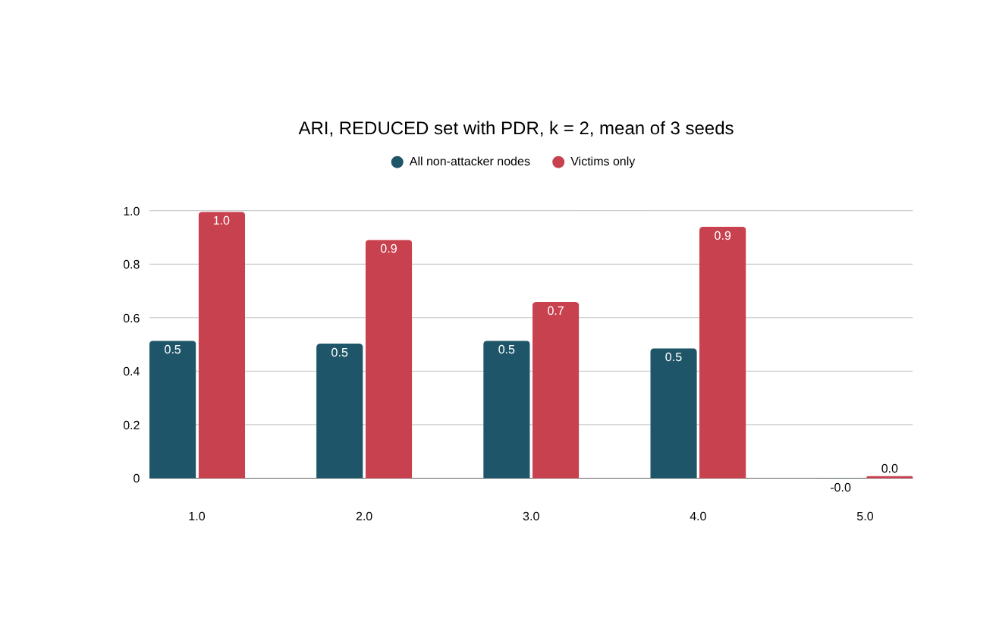
Blackhole clustering: PDR carries all the separation
0.514
K-Means ARI on all non-attacker nodes; best possible is 0.515
≈ 0
every algorithm, every k, without PDR (−0.016 to 0.002)
Remove one feature and the separation disappears: the blackhole leaves no mark on signal strength or topology.
How to read it
Question: How well does each clustering method recover the blackhole label?
How to read: One pair of bars per method. Height = ARI: 0 = no better than chance, 1 = perfect match. Dark blue = all non-attacker nodes, red = victims only (REDUCED set, k = 2, mean of 3 seeds).
What you see: On victims, K-Means matches almost perfectly (0.996). On all nodes every method stops near 0.5, the best possible here, because bystanders carry the attack label but behave normally.
NIS16 | Cross-Layer Dataset of an ESP32 ESP-WIFI-MESH Network | Thesis 3
28
Notes:
KEY FACTS
- DBSCAN finds 5 to 9 clusters; it agrees with K-Means
- Spectral finds the attack on one seed and not the others; reported, not relied on
- FULL set: K-Means mean ARI 0.172 (per seed 0.515, 0.000, 0.000); DBSCAN 0.476 / 0.929
- Silhouette trap: on FULL, K-Means and Ward score their best silhouette at k = 2 (0.77, 0.90) but the split is not the attack (seed 7: 44 windows of extreme RSSI variance; seed 123: one window with a parent change). Attack recovered at k = 4 (0.505)
- Lesson: choose k with elbow, silhouette and interpretability together, as planned in Chapter 4
- Robustness: inside every site and topology K-Means stays within 0.03 of that subgroup's ceiling (star 0.999, no bystanders)
- Run-level check: one model on all windows gives ARI 0.511, 95% interval 0.41 to 0.63 when the 36 runs are resampled
- K-Means cluster B (seed 42): 1,010 windows, 99.4% attack-phase, mean PDR 0.000; RSSI barely differs from cluster A
IF ASKED
- "Why did silhouette say k = 2 is best when that split isn't the attack?" Silhouette measures shape, not agreement with the label
SOURCE: Sections 6.4.2 to 6.4.4, Tables 6.25 and 6.26, Figure 6.18
28

Slide 31
Why 0.514 is the best possible score
Attack-labelled windows of non-attacker nodes (38,232)
Victims: 21,733 (56.8%) delivery lost
Bystanders: 16,499 (43.2%) traffic untouched
1
The phase label marks every board of a blackhole run as "attack", bystanders included
0.514
K-Means, all non-attacker nodes
2
A bystander's PDR stays at 1.000, so no feature can show an attack that never reached it
0.515
best possible on these labels
3
Best possible split: victim attack windows vs. everything else. Its ARI is 0.515, purity 0.870
0.996
K-Means, victims only
NIS16 | Cross-Layer Dataset of an ESP32 ESP-WIFI-MESH Network | Thesis 3
29
Notes:
KEY FACTS
- Contingency of the best split: cluster 1 = 21,733 victim attack windows; cluster 2 = 16,499 bystander attack + 89,140 normal; N = 127,372
- ARI of that split = 0.515 (worked example in the study guide reproduces it exactly); purity (21,733 + 89,140) / 127,372 = 0.870 = K-Means' purity
- So K-Means found essentially exactly the windows in which the attack is felt
- This is a property of how labels are defined (by phase, per run), not a flaw in the data; the paper reports both populations for that reason
IF ASKED
- "ARI 0.514 is mediocre." The ceiling is 0.515 because 43.2% of attack-labelled windows are bystanders; victims alone score 0.996
SOURCE: Sections 6.4.2 and 6.4.3, Table 6.25
29

Slide 32
PCA and t-SNE: how to read the pictures
PCA
t-SNE
PC2
PC1
far apart: the distance means nothing
  Rotates the data so axis 1 holds the most variance, axis 2 the next
  Axes are in standardised feature units; the percentage on an axis is the variance it holds
  A few extreme windows can stretch it into a thin column (Figure 6.22)
  Places windows with similar features near each other
  Axes have no units; only nearness means anything
  Never read the distance between far islands
A group in a picture is not a cluster; a cluster is what an algorithm returns. We use these pictures to describe the data, and the scores decide whether a separation exists.
NIS16 | Cross-Layer Dataset of an ESP32 ESP-WIFI-MESH Network | Thesis 3
30
Notes:
KEY FACTS
- PCA (principal component analysis): PC1 holds the most variance, PC2 the next; Figure 6.22 PC1 30%, PC2 18%; Figure 6.23 PC1 38%, PC2 32%
- In Figure 6.22 PCA is squashed into a column because a few extreme RSSI-variance windows dominate the first component
- t-SNE: perplexity 40 in all figures; only nearness is meaningful; no units on the axes
- Both are drawn on a sample of 6,000 windows of non-attacker nodes
- Pictures describe; the clustering scores (ARI, purity, silhouette) and the single-feature audit are the evidence
IF ASKED
- "The red island looks like a detector." It is a picture of delivery loss (PDR); with PDR removed the same windows overlap (next slide), and the paper states that PDR is also the verifier's own check
SOURCE: Section 4.4 and Section 6.4.3, Figures 6.22 and 6.23
30

Slide 33
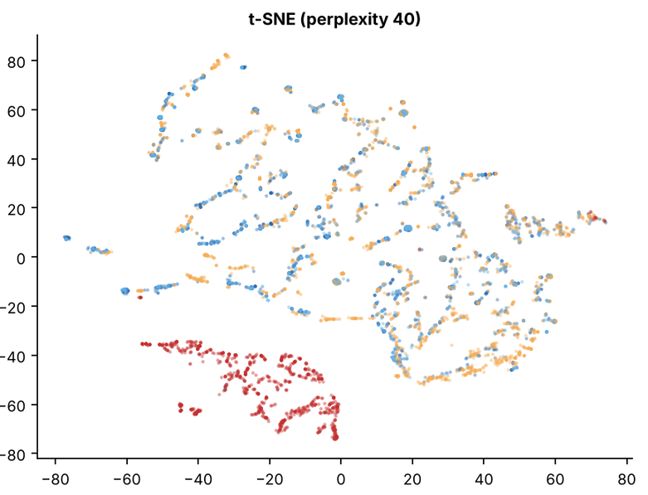
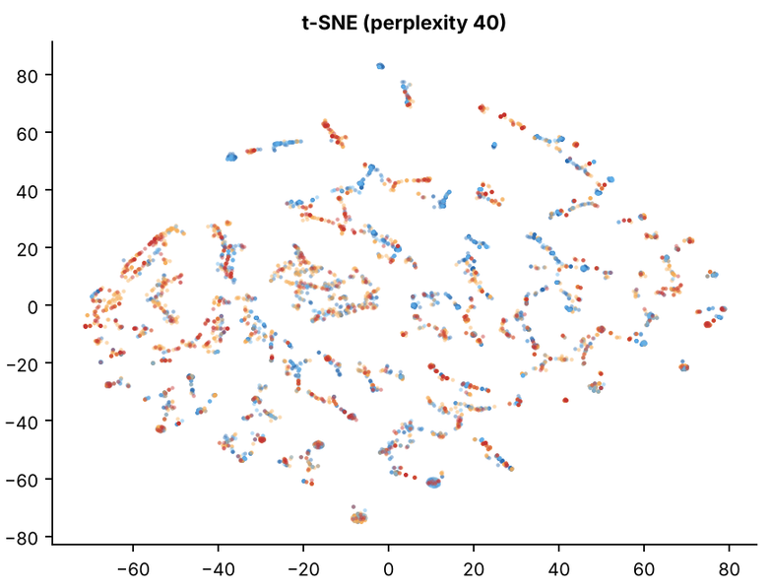
The same windows, with and without PDR
With PDR (FULL set, 8 features)
PDR removed (3 RSSI features)
Victim, attack
Bystander, attack
Victim, normal
Bystander, normal
How to read it
Question: Do the attack seconds form their own group, with and without PDR?
How to read: Each dot = one second of one board (6,000 sampled). Dots close together have similar values; the axes have no units. Red = victim attack, light blue = bystander attack, orange = victim normal, dark blue = bystander normal.
What you see: With PDR (left) the red dots form their own island. Without PDR (right) all four colours are mixed: there is no attack group to find.
NIS16 | Cross-Layer Dataset of an ESP32 ESP-WIFI-MESH Network | Thesis 3
31
Notes:
KEY FACTS
- Left: the red victim attack windows form their own island; light-blue bystander attack windows sit among the normal ones
- Right: same windows with only RSSI_mean, RSSI_var, RSSI_Hop_Diff; all four groups overlap: no structure to find
- PCA panels (in the paper): FULL set PC1 30%, PC2 18%; squashed by a few extreme RSSI-variance windows
- A group in a picture is not a cluster; a cluster is the output of an algorithm
SOURCE: Figures 6.22 and 6.23
31

Slide 34
Wormhole results
6B
Did the tunnel work, what it changed, and what clustering finds
16

Slide 35
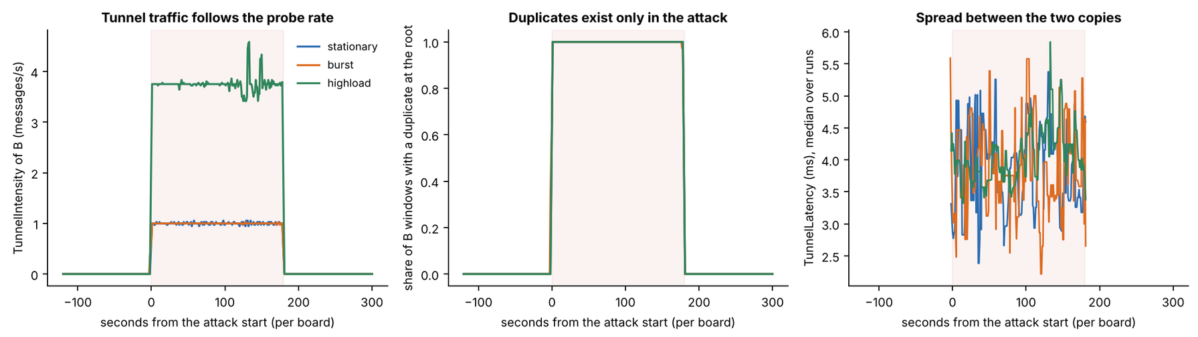
Wormhole: confirmed in all 36 runs
36 / 36
99.86%
0
3.9 ms
wormhole runs confirmed (21 strong, 15 good)
of end B's probes reached the root twice (12,448 of 12,465)
duplicates in baseline or cooldown, and none from other boards
median gap between the two copies of a probe
How to read it
Question: Did the tunnel work, and only during the attack?
How to read: Shaded = the 180 s attack. Left: end B's tunnel messages per second. Middle: share of B's seconds with a duplicate at the root (0 to 1). Right: gap between the two copies (ms). Colour = scenario.
What you see: Left and middle are 0 before and after the attack and jump up only inside it (highload about 4 messages/s). The gap exists only during the attack and is a few ms.
NIS16 | Cross-Layer Dataset of an ESP32 ESP-WIFI-MESH Network | Thesis 3
19
Notes:
KEY FACTS
- Table 6.11: DuplicateRate of B 36/36 (baseline 0 in every run, attack 0.986 to 1.000); TunnelIntensity 36/36 (baseline ≤ 0.001 msg/s, attack 0.994 to 4.0)
- 6,468 of 6,469 attack windows of B held a duplicate (99.98%)
- B was deeper than A in every run; both ends kept the same hop for the whole run
- Hops skipped 1 to 5: linear 2 to 5 (median 4), partial mesh 1 to 2, star 1 (A is the hub), tree 1 to 2
- The wire: end A received 99% to 101% of what B sent, all 36 runs
- Spread: 90th percentile 12.1 ms, 99th 417 ms (84 windows above 200 ms); no link with hops skipped (Spearman 0.25, p = 0.14)
- Out-of-order arrivals rare: 232 of 24,913 (0.93%), mostly 3 highload runs
- Grades: 15 good = 9 partial mesh plain-tree notes + 6 runs with no saved root run log
IF ASKED
- "Why does the wormhole have no victims?" Only B's own probes are tunnelled; the attack is the duplication
SOURCE: Section 6.2.2, Table 6.11, Table 6.12, Figures 6.4 to 6.6
19

Slide 36
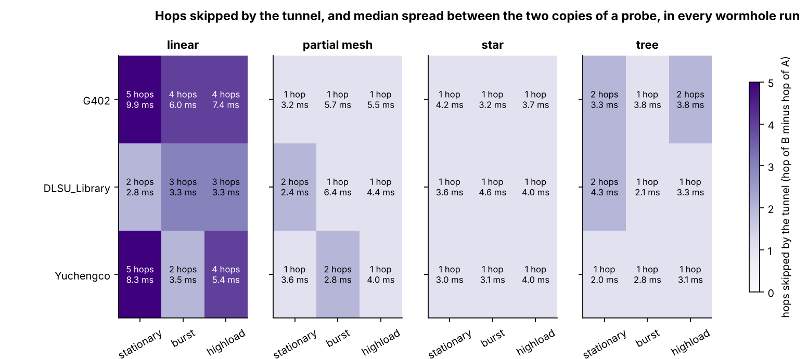
Figure 6.4: hops skipped by the tunnel, every wormhole run
How to read it
Question: How many hops did the tunnel skip in each wormhole run, and how far apart did the two copies arrive?
How to read: Each tile = one run (panel = topology, row = site, column = scenario). Darker purple = more hops skipped (1 to 5). The second number = the typical gap between the two copies (ms).
What you see: Only linear skips many hops (2 to 5); the star always skips 1. Gaps stay between 2 and 10 ms. The 5-hop linear tiles are the highest, but across all runs there is no clear trend (Figure 6.6).
NIS16 | Cross-Layer Dataset of an ESP32 ESP-WIFI-MESH Network | Thesis 3
45
Notes:
KEY FACTS
- Hops skipped: linear 2 to 5 (median 4), partial mesh 1 to 2, star 1 (A is the hub, D-28), tree 1 to 2
- In every run B was deeper than A and both ends kept their hop for the whole run
- Spearman 0.25, p = 0.14: no relation can be claimed from 36 runs
SOURCE: Section 6.2.2, Table 6.12, Figure 6.4
45

Slide 37
How to read box plots and Cohen's d
A box plot (Figures 6.9, 6.12, 6.15)
Cohen's d: how big is the shift?
upper whisker (≤ 1.5 × IQR)
d = (attack mean − baseline mean) ÷ pooled SD
most features: |d| < 0.1
blackhole victim PDR: |d| = 29.71,
far off this scale
75th percentile (top of the box)
median (the line)
negligible
small
medium
large
0
0.2
0.5
0.8
1.0
25th percentile (bottom of the box)
  Negative = lower during the attack
  A size, not a significance test: the windows of one board follow each other, so they are not independent
  Wormhole ends: TunnelIntensity d = 1.83; wormhole non-attacker nodes: largest |d| = 0.06
lower whisker
Box = IQR, the middle half of the values. Blue = baseline, red = attack. Boxes that overlap mean the feature did not change.
Worked check: d = −29.71 with means 0.998 → 0.000 implies a pooled SD of about 0.034 (0.998 ÷ 29.71). The mean moved almost 30 typical spreads.
NIS16 | Cross-Layer Dataset of an ESP32 ESP-WIFI-MESH Network | Thesis 3
23
Notes:
KEY FACTS
- IQR = interquartile range: from the 25th to the 75th percentile; whiskers reach the furthest value within 1.5 IQR; the figures' titles say "boxes: IQR, whiskers 1.5 IQR"
- Panels marked "one value in every box" are features that never varied (for example ParentSwitchRate, HopChangeCount)
- Cohen's d: |d| below 0.2 negligible, about 0.5 medium, 0.8 or more large
- Victim PDR: baseline 0.9977, attack 0.0000, d = -29.71; every other feature of victims and bystanders |d| < 0.1 (largest: bystanders' RSSI_var, -0.09)
- d describes size only: windows of one board are not independent, so no p-values are claimed from d
IF ASKED
- "Why no significance test?" Windows follow each other in time; the real sample size is closer to 80 runs than 456,195 windows (Section 6.5.4)
SOURCE: Sections 6.3.1 and 6.3.2, Tables 6.18 and 6.19
23

Slide 38
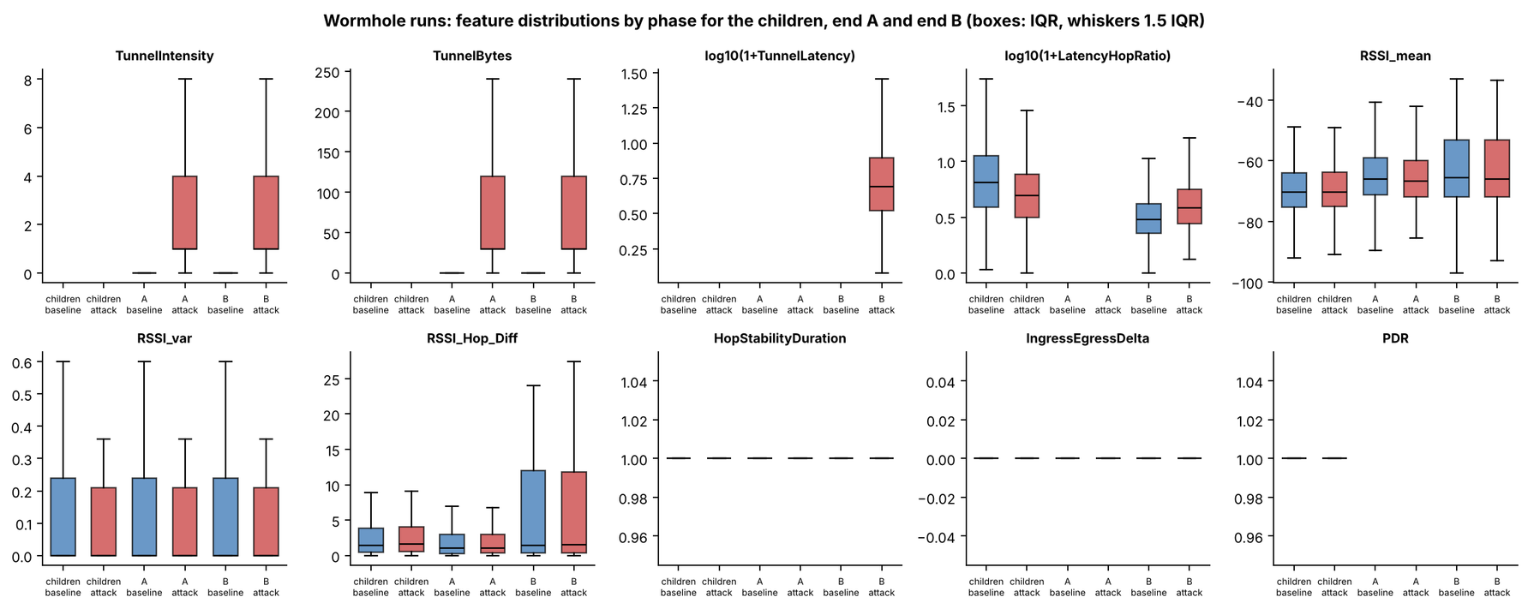
Figure 6.12: wormhole feature distributions by phase
How to read it
Question: Which features change in the wormhole, and on which boards?
How to read: One panel per feature; boxes for the other children, end A and end B, each baseline (blue) then attack (red). The tunnel features exist only on the two ends.
What you see: Only the tunnel panels change, and only on A and B during the attack. The signal-strength boxes are the same before and during the attack.
NIS16 | Cross-Layer Dataset of an ESP32 ESP-WIFI-MESH Network | Thesis 3
49
Notes:
KEY FACTS
- TunnelIntensity d = 1.83; TunnelBytes 0 to 57.5 bytes (30 bytes x 1.92)
- B's RetryRate rises 0.00 to 0.50, but that counter holds the tunnelled frames, not retries
- Non-attacker nodes: PDR 0.9999 to 0.9999, largest |d| = 0.06
SOURCE: Section 6.3.2, Table 6.19, Figure 6.12
49

Slide 39
Figure 6.6: spread between the two copies of a probe
How to read it
Question: How far apart do the two copies of a probe arrive, and does that grow with the hops skipped?
How to read: Left: one box per topology; the y-axis is logarithmic (each step = ×10). Box = middle half, whiskers = 5th to 95th percentile, dots = rare extremes. Right: one dot per run, hops skipped vs. typical gap; shape = scenario.
What you see: The typical gap is a few ms in every topology, with rare long delays. The 4- and 5-hop runs sit a bit higher, but the link is weak and not significant (Spearman 0.25, p = 0.14).
NIS16 | Cross-Layer Dataset of an ESP32 ESP-WIFI-MESH Network | Thesis 3
46
Notes:
KEY FACTS
- Median spread 3.9 ms, 90th percentile 12.1 ms, 99th percentile 417 ms (84 windows above 200 ms)
- Log scale: each gridline is ten times the one below
SOURCE: Section 6.2.2, Figure 6.6
46

Slide 40
Wormhole predictions: traffic yes, radio and routing no
Prediction (Table 3.5) | Observed? | Measured
Hop counts change | No | 0 windows with a hop change in any phase
Impossible parent links | No | 0 windows with a parent change
RSSI does not fit the depth | No | RSSI_Hop_Diff A 2.79 → 2.76 dB; B 5.41 → 5.68 dB
RSSI variance rises | No | Cohen's d −0.03 (A), −0.07 (B)
Duplicate arrivals at the root | Yes | 6,468 of 6,469 attack windows of end B
Latency mismatch between copies | Yes | Median spread 3.9 ms
What belongs to the traffic the tunnel creates was observed; what belongs to routing and radio was not.
NIS16 | Cross-Layer Dataset of an ESP32 ESP-WIFI-MESH Network | Thesis 3
22
Notes:
KEY FACTS
- Table 3.5 has nine wormhole indicators; Table 6.16 gives each with what was measured in the 36 wormhole runs
- Observed: the three that belong to the traffic the tunnel creates (duplicate arrivals, frame arrival pattern, latency mismatch between the two copies)
- Not observed: hop count, parent-child validity, RSSI vs. hop, RSSI variance
- Not measurable: routing table entries (the firmware does not log the routing table); retransmissions near the ends (B's counter holds tunnel frames; others 0)
- Out-of-order arrivals: rare (0.93%)
- Exactly what an application-layer tunnel implies (D-20)
SOURCE: Section 6.2.4, Table 6.16

Slide 41
Wormhole and pooled clustering
Wormhole: cross-layer features find nothing
Pooled: 80 runs, three labels
  Non-attacker boards: ARI −0.012 to 0.003, every algorithm and k
  Tunnel ends with the RSSI features: −0.012 to 0.009
  Diagnostic only, TunnelIntensity added: DBSCAN reaches 0.827 on end B
  The tunnel signal exists, but in the attackers' own counters, not in the cross-layer features
0.333 K-Means ARI; best possible 0.334
As a detector (one model applied to all windows):
Group | In the "victim" cluster
Victim attack windows | 21,733 of 21,733
Benign windows | 0 of 22,481
Normal, blackhole runs | 183 of 89,140
Wormhole attack windows | 3 of 32,194
NIS16 | Cross-Layer Dataset of an ESP32 ESP-WIFI-MESH Network | Thesis 3
32
Notes:
KEY FACTS
- Wormhole diagnostic: K-Means k = 2 on B gives ARI 0.000 because it splits by signal level (-67.6 vs -47.1 dBm, varies between runs); k = 3 isolates the highload tunnel windows (ARI 0.141); DBSCAN 9 to 12 nearly pure clusters
- TunnelIntensity is excluded from model inputs by the leakage guard; it was added only to ask whether any tunnel signal exists
- Pooled set: non-attacker boards of all 80 runs, 257,258 windows; labels normal 0, blackhole 1, wormhole 2
- Ceiling 0.334 (80 runs) and 0.317 (72 attack runs) on the 6,000-window samples; K-Means 0.333 and 0.315 = it finds the blackhole victims and nothing else
- Without PDR: -0.023 to 0.005
- Adding or removing the benign runs changes K-Means' ARI by only 0.017
- Bystander attack windows in the victim cluster: 0
SOURCE: Sections 6.4.6 and 6.4.7, Tables 6.28 and 6.32, Figures 6.25 and 6.30
32

Slide 42
Benign runs and both attacks
6C
The control runs, the single-feature audit, the side-by-side comparison and what it all means
16

Slide 43
Benign runs: no attack signature
8 / 8
0 of 21
24 of 24
benign runs confirmed benign, all strong
evaluable signature checks passed
cooldown comparisons within 0.5 baseline SD
?
How a benign run is tested
!
What 8 runs can and cannot show
  Same tests, pointed the other way: cooldown against baseline
  No signature may pass; delivery must stay healthy (PDR ≥ 0.90, every relay forwards ≥ 90%)
  Mean PDR per run: 0.9994 to 1.0000
  Enough as a control: none triggered the verifier
  Not enough for a false-alarm rate; the paper says so and recommends more benign runs
  Within one topology, benign scenario and site are confounded
NIS16 | Cross-Layer Dataset of an ESP32 ESP-WIFI-MESH Network | Thesis 3
20
Notes:
KEY FACTS
- 43 other checks needed a tunnel or an attacker, so they had no data, as expected
- Only 4 of 54 child boards ever had a window below PDR 1, all in linear/G402/highload (lowest 0.75)
- Benign runs: no hop change in any run; 1 parent change across all 8 runs
- Probe rate matches the scenario in both kinds of run (about 1.0, 1.1 and 3.9 per board per second)
- Tree and partial mesh have one benign run each, both at G402
IF ASKED
- "Are 8 benign runs enough?" As a control yes; for a false-alarm rate no (Section 6.5.4, Recommendation 2)
SOURCE: Sections 6.2.6 and 6.3.3
20

Slide 44
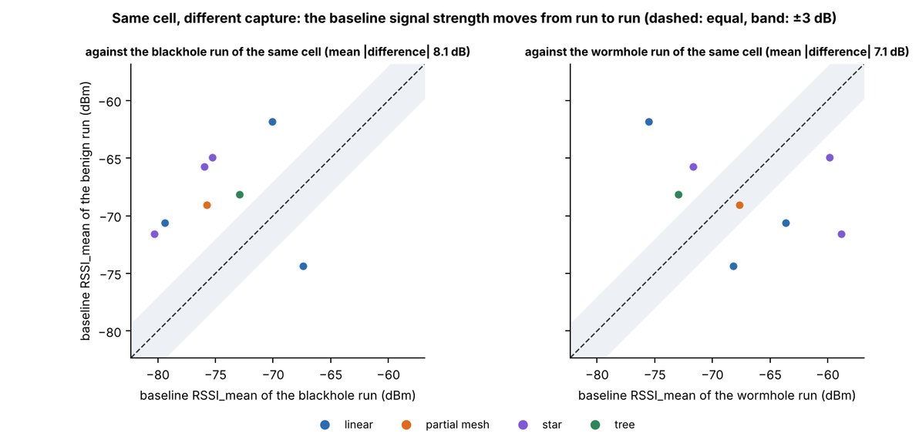
Signal strength separates captures, not attacks
8.1 / 7.1 dB
mean baseline RSSI_mean difference between two set-ups of the same cell (vs. the blackhole run / vs. the wormhole run), in both directions
  Each capture is a fresh set-up; signal strength depends on exactly where each board stands
  RSSI_mean is the only big difference between benign and attack-run normal windows (d = 0.69)
  Benign cooldown stays within 0.5 baseline SDs in 24 of 24 comparisons
  For clustering: RSSI_mean can split windows by set-up instead of by attack
  In the paper: Section 6.3.3, Tables 6.22 and 6.23, Figure 6.16
How to read it
Question: Is the signal strength the same each time we set up the same cell?
How to read: One dot per benign run. Across = baseline signal of the attack run of the same cell (dBm), up = the benign run's. Left: against the blackhole run; right: against the wormhole run. Colour = topology.
What you see: Identical set-ups would put the dots on the dashed line (grey band = within 3 dB). Most dots sit outside, on both sides: each new set-up shifts the signal by about 7 to 8 dB.
NIS16 | Cross-Layer Dataset of an ESP32 ESP-WIFI-MESH Network | Thesis 3
25
Notes:
KEY FACTS
- Mean |difference| 8.1 dB against the blackhole run of the same cell, 7.1 dB against the wormhole run (figure panel titles)
- Points fall on both sides of the equal line and mostly outside the ±3 dB band
- Consequence: one run per cell cannot separate site effects from capture-to-capture variation
IF ASKED
- "Why is RSSI so different between runs of the same cell?" Each capture is a new set-up; RSSI depends on exact board placement
PAPER CHECK
- Every number on this slide is in the paper: 8.1 dB and 7.1 dB (Section 6.3.3, Table 6.23); d = 0.69 (Table 6.22); 24 of 24 within 0.5 SD (Section 6.3.3)
SOURCE: Section 6.3.3, Tables 6.22 and 6.23, Figure 6.16
25

Slide 45
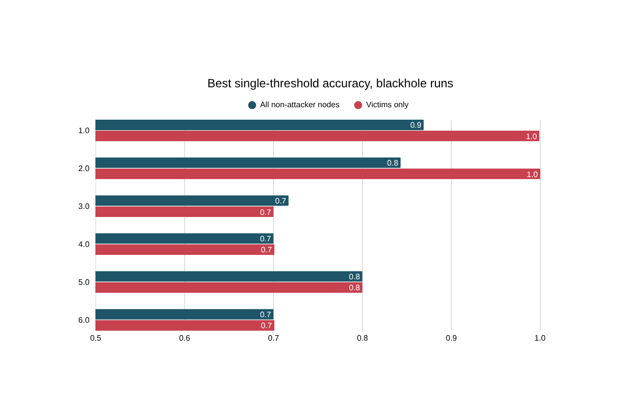
Can one feature decide it? The single-feature audit
  Majority rate ≈ 70%: 420 normal s of 600 s
  PDR separates victims at 99.9%: a full delivery collapse is separable by construction
  Only 86.9% on all nodes: bystanders carry the attack label but behave normally
  LatencyHopRatio is missing when a probe is dropped, which gives the label away, so it is not clustered
  Wormhole: on non-attacker nodes no feature beats 70% by more than 0.01 points
How to read it
Question: Can one feature with one cut-off tell attack seconds from normal ones?
How to read: Each bar = the best accuracy of a single cut-off on that feature (axis starts at 50%). Dark blue = all non-attacker nodes, red = victims only. † = judged only where the feature has a value.
What you see: 70% means "no information": always guessing "normal" already scores 70%. PDR stands out (99.9% on victims). LatencyHopRatio wins only through its blanks, and the run clock (80%) is the fixed schedule, not a feature.
NIS16 | Cross-Layer Dataset of an ESP32 ESP-WIFI-MESH Network | Thesis 3
21
Notes:
KEY FACTS
- Why the audit: if one feature alone separates attack from normal, clustering adds nothing, or the feature is an artefact (Arp et al. [80], spurious correlation)
- Method: best single threshold per feature (looking at the labels), compared with always answering "normal"
- LatencyHopRatio's missingness alone predicts a victim's label with 99.2% accuracy
- Run clock 80%: every run follows the same schedule; kept out of the model inputs
- Every RSSI and topology feature stays at the majority rate
- Wormhole ends: tunnel features 99.7% (they carry messages only in the attack); RetryRate 100% on B only because B's counter holds the tunnelled frames
- Leakage guard: RetryRate, the tunnel features and the relay features may never be model inputs; LatencyHopRatio also excluded
IF ASKED
- "If PDR alone detects the blackhole, why cluster at all?" That is what this audit tests and we report it; any future model must beat a plain PDR threshold (Recommendation 5)
SOURCE: Section 6.2.3, Tables 6.13 and 6.14
21

Slide 46
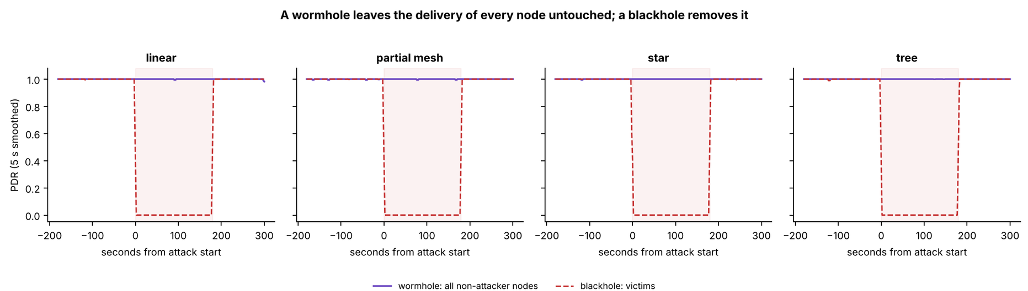
EDA: only the delivery of the victims moves
Blackhole: victim PDR 0.998 → 0.000, Cohen's d = −29.71. Every other feature of victims and bystanders: |d| < 0.1.
Wormhole: non-attacker PDR 0.9999 → 0.9999; largest |d| = 0.06. On the ends only the tunnel features change (0 → 1.92 msg/s).
How to read it
Question: Does the wormhole hurt delivery the way the blackhole does?
How to read: Time runs left to right (shaded = attack). Height = PDR, the share of probes that reached the root. Solid purple = wormhole runs, non-attacker boards. Dashed red = blackhole victims.
What you see: Purple stays at 1 for the whole run; red drops to 0 for the whole attack. The wormhole does not stop delivery, the blackhole does.
NIS16 | Cross-Layer Dataset of an ESP32 ESP-WIFI-MESH Network | Thesis 3
24
Notes:
KEY FACTS
- Cohen's d = (attack mean - baseline mean) / pooled SD; |d| < 0.2 negligible, 0.8+ large; descriptive only, windows are not independent
- d = -29.71 implies a pooled SD of about 0.034: the mean moved almost 30 times the typical spread
- Victims' RSSI is about 2.5 dB weaker than bystanders' already in the baseline (-74.7 vs -72.2 dBm): they sit deeper
- Bystanders' LatencyHopRatio falls 4.26 -> 3.15 -> 2.46 ms/hop and keeps falling after the attack; benign runs show the same, so it follows the course of a run
- Correlations: the strong pairs are formula-linked (ForwardingRatio vs ConsistencyScore, Spearman -0.94); no other FULL-set pair exceeds |0.4|
- Wormhole ends: TunnelIntensity d = 1.83; TunnelBytes 0 -> 57.5 bytes; B's RetryRate 0.00 -> 0.50 is the tunnel counter, not retries
- RSSI_Hop_Diff is higher on B (5.4 dB vs 2.7 to 2.8) but equally high before the attack: it reflects where B sits
SOURCE: Sections 6.3.1 and 6.3.2, Tables 6.18 and 6.19, Figures 6.9 to 6.12
24

Slide 47
Discussion: the attacks live in the data plane
Run type | Direct record | Cross-layer features that changed | Clustering
Blackhole | Attacker FR → 0.000–0.007; victim PDR 0.998 → 0.000 | Victim PDR only (d = −29.7); all others |d| < 0.1 | 0.514 (ceiling 0.515); ≈ 0 without PDR
Wormhole | B's probes reach the root twice (99.86%) | None (|d| ≤ 0.07; hop and parent unchanged) | ≈ 0 without a tunnel feature
Benign | 0 of 21 signature checks passed | Cooldown within 0.5 SD in 24 of 24 | 0 of 22,481 in the victim cluster
Main reading: Chapter 4 expected cross-layer evidence. The evidence sits in delivery (blackhole) and duplication (wormhole); PHY, MAC and network features stay where they were.
Honest qualifier: PDR is also the verifier's check, so the clustering finds the effect the verifier measured. It is not independent evidence that cross-layer features detect the blackhole.
NIS16 | Cross-Layer Dataset of an ESP32 ESP-WIFI-MESH Network | Thesis 3
33
Notes:
KEY FACTS
- Three consequences of emulation (6.5.3): results describe this kind of attack, not a routing-protocol attack; a detector here is tested on delivery loss and duplication; whether cross-layer features add anything stays open
- Limits (6.5.4): one run per cell; windows are not independent, so the real sample size is closer to 80 runs than 456,195 windows; partial mesh = plain tree; tree fan-out differs; no routing-table logging; sniffer on 7 runs; 8 boards indoors
IF ASKED
- "So your cross-layer features failed?" They did not respond to these attacks because these attacks never touch radio or routing; whether they help against routing attacks is Recommendation 1
SOURCE: Sections 6.5.1 to 6.5.4, Table 6.33
33

Slide 48
Compared with published studies
Measure | This study | Published | Reading
Baseline PDR | 0.998 victims; 0.9994–1.0000 benign | > 0.97, Khan et al. [22], ESP32 | Agree in size; counting differs
PDR under blackhole | 0.000 | 25–40% delivery, Airehrour et al. [70], RPL | Same direction; larger here (attacker on the path by placement)
Parent changes under blackhole | 0.00000 → 0.00009 per s | 16 to 246 rank changes [70] | Differs: their attack acts on routing (D-20)
Wormhole hop count | Constant | 4 → 3 hops, Zhukabayeva et al. [71], ZigBee | Their tunnel is a route; ours an app relay
Wormhole delay | 3.9 ms spread; B's LatencyHopRatio unchanged | 80–100 → 120–200 ms (about +40%) [71] | Different measure
Duplicate arrivals | 99.86% of B's probes; 0 in baseline | Proposed as a signature, Ramírez Gómez et al. [72] | Same evidence, different layer
Platforms, scales and protocols differ, so the comparison is about direction and rough size, not equal values.
NIS16 | Cross-Layer Dataset of an ESP32 ESP-WIFI-MESH Network | Thesis 3
34
Notes:
KEY FACTS
- Khan's figure is above 97% at every node except one outdoor node, from a multi-day stability test; ours is per one-second window
- Bystanders' baseline PDR 0.996
- Zhukabayeva's tunnel was GSM/GPRS; ours is a short UART wire, so the delay change is not expected to match
SOURCE: Section 6.5.2, Table 6.34
34

Slide 49
Chapter 7: Conclusion
7
What the objectives came to, what we contribute, our limits and recommendations
35
Notes:
35

Slide 50
The three objectives, answered
Build an ESP32 mesh testbed with normal and attack traffic
80 of 80 runs; attacks confirmed in 72 of 72, benign in 8 of 8. Qualifiers: emulated attacks; partial mesh = branched tree
1
Achieved
Collect PHY, MAC and network features into a labelled dataset
16 features, labels from the schedule, every change documented (D-1 to D-37). Qualifier: no MAC retry count (D-15)
2
Achieved
Evaluate separability with EDA and clustering
Blackhole: through PDR only (0.514 vs 0.515). Wormhole: not with cross-layer features (−0.012 to 0.009)
3
Differs by attack
The expected cross-layer evidence was not found, because both attacks left radio and routing unchanged. We report this as a finding, not a failure.
NIS16 | Cross-Layer Dataset of an ESP32 ESP-WIFI-MESH Network | Thesis 3
36
Notes:
KEY FACTS
- Objective 3 detail: blackhole without PDR -0.016 to 0.002; pooled 80 runs, 3 labels: 0.333 vs best 0.334
- Wormhole visible only through the ends' counters and duplicate arrivals at the root
- Dataset validity (7.3): 72 attack runs passed (67 complete, 5 minor gaps); 1,372 windows (0.30%) dropped; 637 files none empty; one board (B768, bystander) with no data
IF ASKED
- Weak spots in Chapter 7 text: §7.3 typo "he attack" (missing T); §7.6 stray backtick after "directly"
SOURCE: Sections 7.3 and 7.4
36

Slide 51
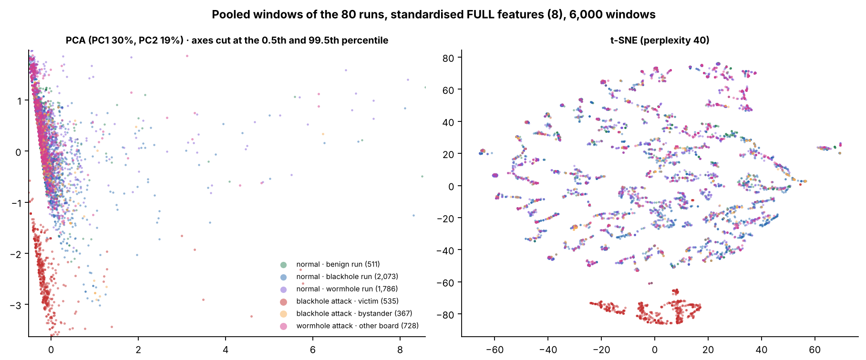
Figure 6.30: pooled 80 runs, FULL set
How to read it
Question: Pooled 80 runs, all 8 features: does any group stand apart in 2-D?
How to read: Each dot = one second (6,000 sampled). Left: PCA (30% and 19% of the spread, extreme dots cut off). Right: t-SNE (only nearness counts). Six colours = three kinds of normal and three kinds of attack second.
What you see: Only the red dots (blackhole victims under attack) stand apart, in both pictures. The other five groups, wormhole attack included, are mixed together.
NIS16 | Cross-Layer Dataset of an ESP32 ESP-WIFI-MESH Network | Thesis 3
65
Notes:
KEY FACTS
- 6,000 sampled windows; legend counts in the figure
SOURCE: Section 6.4.7, Figure 6.30
65

Slide 52
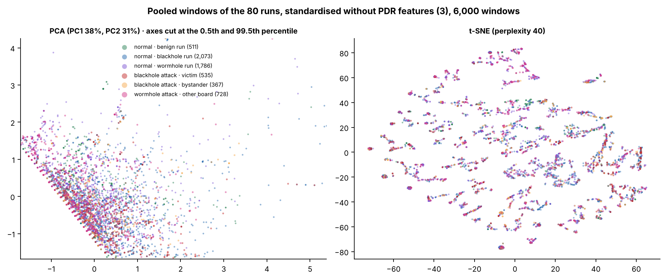
Figure 6.31: pooled 80 runs, PDR removed
How to read it
Question: The same pooled picture with PDR removed: anything left?
How to read: Only the three RSSI features are used. Left: PCA (38% and 31% of the spread). Right: t-SNE. Same six colours as Figure 6.30.
What you see: All six groups are mixed, the red one too: without PDR the pooled data show no structure.
NIS16 | Cross-Layer Dataset of an ESP32 ESP-WIFI-MESH Network | Thesis 3
66
Notes:
KEY FACTS
- Without PDR the pooled ARI is -0.023 to 0.005
SOURCE: Section 6.4.7, Figure 6.31
66

Slide 53
Findings and contributions
Four findings
Three contributions
1
Blackhole: clear delivery loss among victims; PDR is the strongest indicator
1
Testbed
An ESP32 mesh for normal operation and two attacks under varied conditions
2
Wormhole: duplicate arrivals at the root, consistently and only during the attack
2
Dataset
80 runs with topology, site, scenario, role and phase on every row
3
Retransmissions, parent changes, hop counts and signal-to-hop did not change
3
Verification
A process that separates real attack effects from missing data or broken runs
4
Clustering depends on the feature tied to the attack: remove it and separation collapses
NIS16 | Cross-Layer Dataset of an ESP32 ESP-WIFI-MESH Network | Thesis 3
37
Notes:
KEY FACTS
- Finding 3 = the Table 3.4 and 3.5 rows that did not hold; kept as written on purpose
- Firmware and tools are in the project repository [79]
- Most important limitation: application-layer attacks (D-20)
SOURCE: Section 7.5
37

Slide 54
Limits and what should come next
Limitations
Recommendations
  Application-layer attacks only
  Only 8 boards, three indoor sites
  Only 8 benign runs: no reliable false-alarm rate
  No direct MAC retry count; sniffer on some runs only
  One run per condition
  Strong results rest on features tied to how the attacks were built
1
Attack routing directly
modifiable routing or forged management frames
2
Collect more normal data
benign runs in every cell, with repeats
3
Improve network measurement
a sniffer on every run
4
Test more wormhole scenarios
tunnel other nodes' traffic, other layouts
5
Evaluate detectors fairly
hold out whole runs; beat a PDR or duplicate baseline
NIS16 | Cross-Layer Dataset of an ESP32 ESP-WIFI-MESH Network | Thesis 3
38
Notes:
KEY FACTS
- Rec 1: see whether parent, hop, retry and RSSI features react once an attack really manipulates routing
- Rec 2: estimate a false-alarm rate across every topology, site and scenario
- Rec 3: also compare Tables 3.4 and 3.5 with what the testbed can actually measure
- Rec 5: hold out whole runs as test data; compare against simple baselines (PDR for blackhole, duplicates for wormhole); test with the main attack feature removed
IF ASKED
- "Do your results generalise?" No claim beyond 8 ESP32 boards, three indoor sites, three scenarios and application-layer attacks (6.5.4)
SOURCE: Sections 7.5 and 7.6
38

Slide 55
Thank you
Notes:
KEY FACTS
- Final conclusion (7.7): detection depended on delivery and duplication; the other cross-layer features did not separate the attacks in this setup
- Because the attacks were application-layer, the results are not proof for routing-level attacks
SOURCE: Section 7.7
39

Slide 56
Backup: the other figures
B
40
Notes:
KEY FACTS
- Not part of the timed talk: these are reference slides
- Each slide has the figure and a "How to read it" guide: what the axes are, what the colours mean, and the one thing to look for
- Figure numbers are the paper's own numbering
40

Slide 57
Backup B1: blackhole figures
B1
16

Slide 58
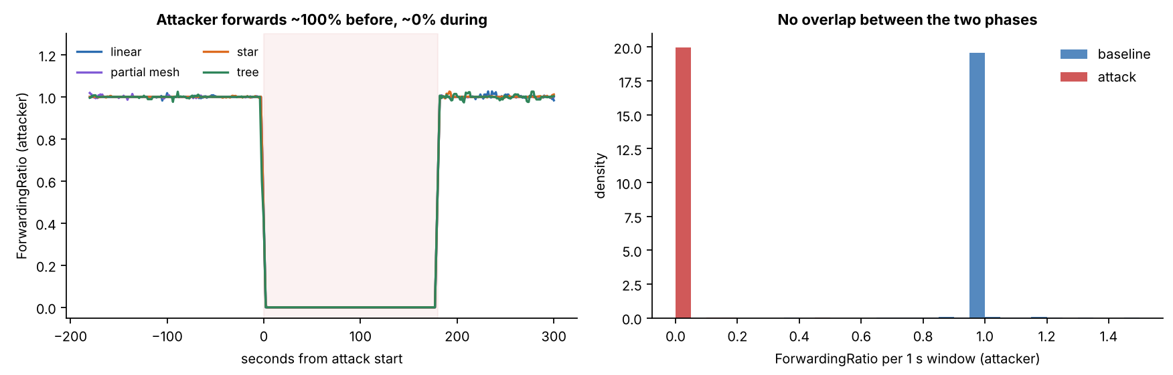
Figure 6.3: the attacker's ForwardingRatio
How to read it
Question: Did the attacker really stop forwarding, and only during the attack?
How to read: Left: time across, ForwardingRatio up (1 = forwards everything, 0 = nothing), one line per topology, shaded = attack. Right: how often each value occurs; blue = baseline, red = attack.
What you see: The line drops from 1 to 0 for exactly the 180 s of the attack and then comes back. On the right, the red and blue bars sit far apart and never overlap.
NIS16 | Cross-Layer Dataset of an ESP32 ESP-WIFI-MESH Network | Thesis 3
44
Notes:
KEY FACTS
- Attacker ForwardingRatio 1.000 to 1.004 in the baseline, 0.000 to 0.007 in the attack, in all 36 runs
- Example run (G402 linear stationary): 1,077 probes received in the attack, 1 forwarded
SOURCE: Section 6.2.1, Table 6.9, Figure 6.3
44

Slide 59
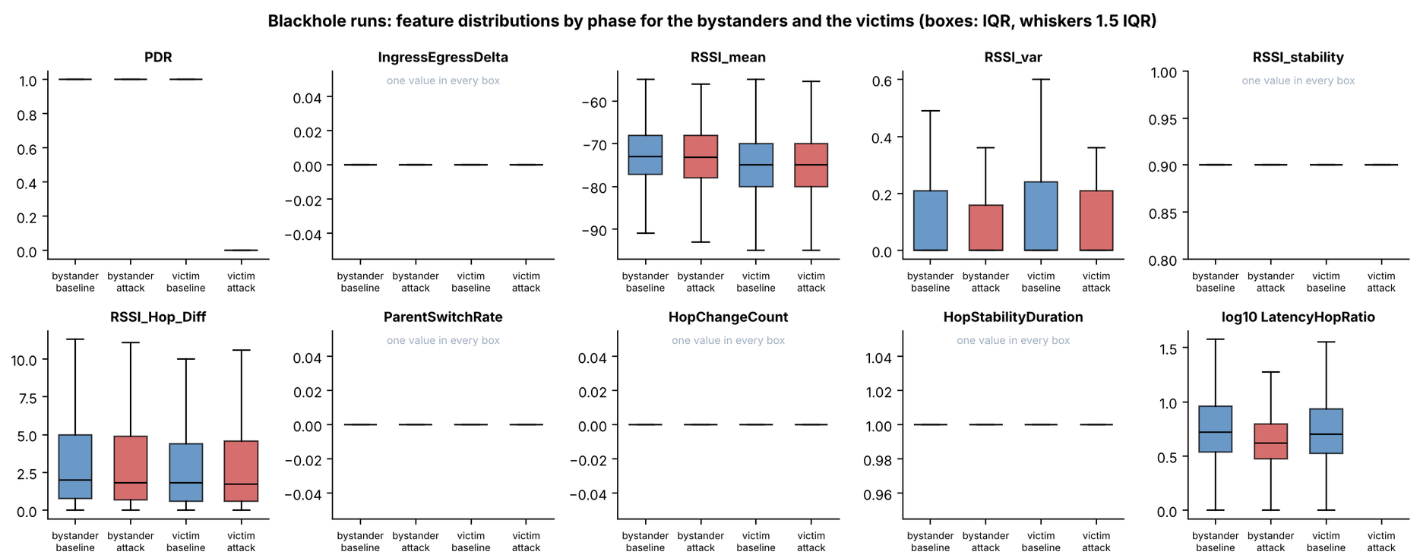
Figure 6.9: blackhole feature distributions by phase
How to read it
Question: Which features change for victims and bystanders when the blackhole starts?
How to read: One panel per feature; four boxes each: bystander and victim, baseline (blue) then attack (red). A box covers the middle half of the values.
What you see: Only PDR moves: the victims' attack box drops to 0. The rest overlap or are one flat value. LatencyHopRatio has no victim attack box: no probe arrived, so there is no delay.
NIS16 | Cross-Layer Dataset of an ESP32 ESP-WIFI-MESH Network | Thesis 3
47
Notes:
KEY FACTS
- Cohen's d: victim PDR -29.71; every other feature of victims and bystanders |d| < 0.1
- Panels marked "one value in every box" never varied
SOURCE: Section 6.3.1, Table 6.18, Figure 6.9
47

Slide 60
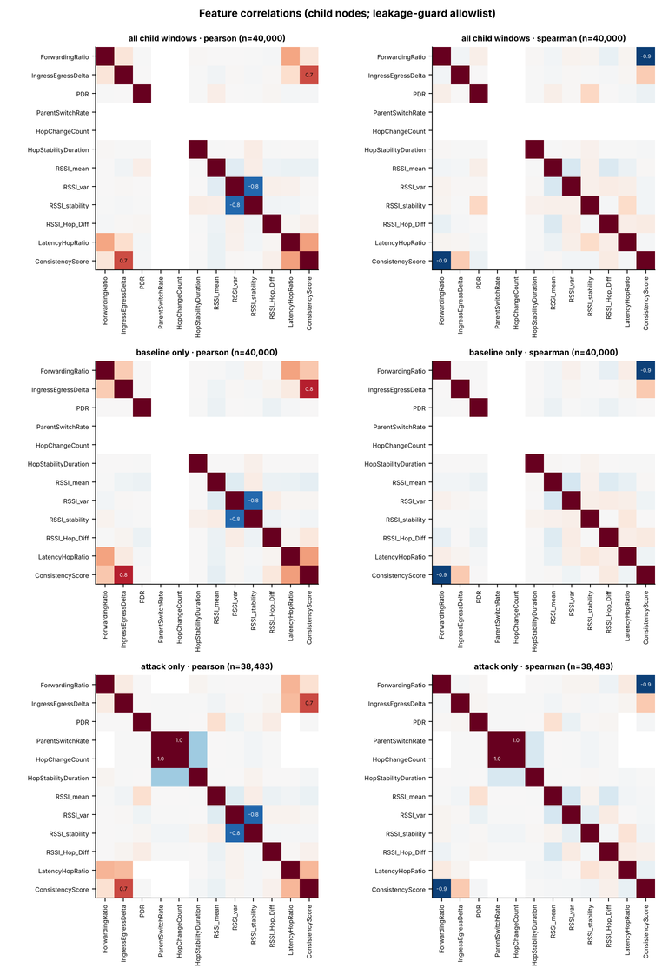
Figure 6.10: correlations between the features
PEARSON
straight-line link
SPEARMAN
rank link
How to read it
What data
Blackhole runs only: the child boards of the 36 blackhole runs (up to 40,000 sampled seconds per square grid). Not the two attacks combined.
How to read
Each square = one pair of features. Its colour is their correlation, from −1 to +1 (scale below). The diagonal is a feature with itself (always +1). Numbers are printed only where the value is 0.5 or more either way. Empty row = the feature never changed.
Left vs. right
Pearson asks whether two features move together along a straight line. Spearman asks only whether one goes up when the other goes up, in any shape. Example: ConsistencyScore vs. ForwardingRatio is 0.12 Pearson but −0.94 Spearman.
Bottom line
Only 4 pairs are strong, and each has a reason in how the features are computed (see notes). No other pair of the 8 clustering features goes past ±0.4.
All Phases
Baseline only
Attack only
−1
−0.5
0
+0.5
+1
one rises, other falls
no link
rise together
NIS16 | Cross-Layer Dataset of an ESP32 ESP-WIFI-MESH Network | Thesis 3
48
Notes:
KEY FACTS
- Data: child boards of the 36 blackhole runs only (paper caption: "Correlations between the Features of the Child Nodes of the Blackhole Runs"); each grid is a sample of up to 40,000 windows (attack grid 38,483)
- Twelve features: those the leakage guard allows in a group that holds the attacker; RetryRate and the tunnel features are not shown
- Pearson = linear (straight-line) correlation; Spearman = rank correlation (does one go up when the other goes up, in any shape)
- Strong pairs are formula-linked, not behaviour-linked: ForwardingRatio vs ConsistencyScore (Spearman -0.94, Pearson 0.12, because ConsistencyScore = |ForwardingRatio - 1|); IngressEgressDelta vs ConsistencyScore (Pearson 0.65, 0.78 in baseline); RSSI_var vs RSSI_stability (Pearson -0.79, Spearman 0.05: a few noisy windows); ParentSwitchRate vs HopChangeCount (1.00 in attack windows)
- Largest other pair: 0.36, ParentSwitchRate vs HopStabilityDuration (attack windows)
- The correlation filter in the clustering removed nothing (largest |r| 0.11 among the allowed features)
IF ASKED
- "Is this both attacks combined?" No, blackhole runs only. The wormhole has its own per-run correlation files in the repository but no paper figure
SOURCE: Section 6.3.1, Figure 6.10
48

Slide 61
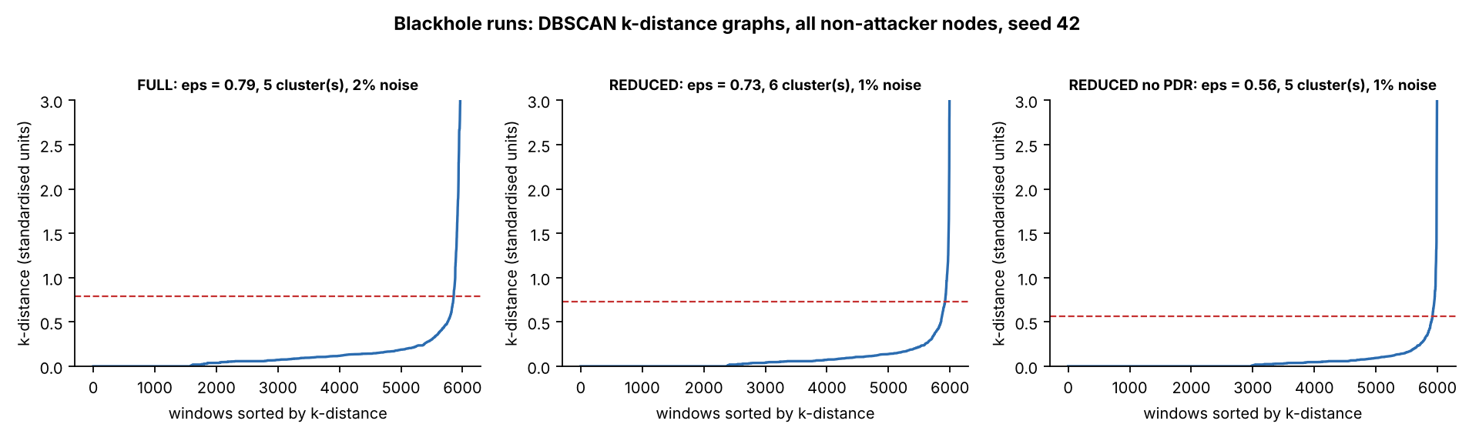
Figure 6.17: choosing eps for DBSCAN
How to read it
Question: How did we choose DBSCAN's neighbourhood size (eps)?
How to read: For each of the 6,000 sampled seconds, take the distance to its k-th nearest neighbour (k = min_samples) and sort from smallest to largest: that is the blue curve (across = rank, not time). Red dashed line = the eps we chose.
What you see: The long flat part is crowded seconds; the sharp bend is where seconds become isolated. eps is set at the bend: 0.79 (FULL), 0.73 (REDUCED), 0.56 (no PDR). Seconds above the line are noise (1 to 2%).
NIS16 | Cross-Layer Dataset of an ESP32 ESP-WIFI-MESH Network | Thesis 3
53
Notes:
KEY FACTS
- DBSCAN groups points that have at least min_samples neighbours within distance eps; a point without enough neighbours is noise
- k-distance graph: each window's distance to its k-th nearest window (k = min_samples), sorted; eps is set at the knee where the curve turns upward
- Values (panel titles, seed 42, all non-attacker nodes): FULL eps 0.79, 5 clusters, 2% noise; REDUCED eps 0.73, 6 clusters, 1% noise; REDUCED without PDR eps 0.56, 5 clusters, 1% noise
- Vertical axis cut at 3; the curves rise to 47, 35 and 33
- min_samples between D+1 and 2D (D = number of features); the setting with the best silhouette is kept
PLAIN EXPLANATION (step by step)
- One point = one second of one non-attacker board, described by its features. Features are standardised (average 0, spread 1), so a distance of 1.0 on the axis is about one standard deviation of difference
- DBSCAN has two settings. eps = the radius of the circle drawn around each point. min_samples = how many points must fall inside that circle for the area to count as crowded. A point in a crowded circle belongs to a cluster; a point with too few neighbours, and no crowded point near it, is noise
- Too small an eps makes almost everything noise; too large an eps merges everything into one cluster. This graph is how eps was chosen instead of guessed
- Building the blue curve: (1) for each of the 6,000 sampled seconds, measure the distance to its k-th nearest neighbour (k = min_samples); small = in a crowd, large = isolated. (2) Sort the 6,000 distances from smallest to largest. (3) Plot them: across = position in the sorted list (not time), up = that distance
- Analogy: 6,000 people in a plaza, each asked how far away their k-th closest person is. Someone in the middle of a crowd says half a metre; someone alone in a corner says twenty metres. Line everyone up from the smallest answer to the largest
- Three parts of each curve: flat at 0 on the left (those seconds have at least k neighbours at the same feature values, so the distance is 0); a slow, gentle rise through the middle (ordinary crowded seconds); a near-vertical jump on the right (the few seconds unlike everything else; the axis is cut at 3)
- The knee is where the gentle rise turns into the vertical jump. The red dashed line is drawn at the height of the knee: that height is eps
- Where the curve crosses the red line: to the left, a second's k-th neighbour is within eps, so it is crowded enough to belong to a cluster; to the right, its k-th neighbour is farther than eps, so it is noise. Only the last 1 to 2% of the sorted list lies to the right, which is why the noise share is small. A few seconds just past the crossing can still join a cluster if they sit within eps of a crowded point
- Why eps differs between panels (0.79, 0.73, 0.56): distance adds up the differences over all features, so fewer features give smaller distances, a lower curve and a lower knee. Removing PDR lowers it the most
ONE-SENTENCE ANSWER
- For each second we measured the distance to its k-th nearest similar second, sorted those distances, and put eps at the bend where the curve shoots upward. Seconds below the bend sit in crowds and form clusters; the few above it (1 to 2%) are isolated and become noise
IF ASKED
- "Why the knee?" Below it, a small eps change adds many points to clusters; above it, only isolated points remain. The knee separates crowded seconds from outliers
SOURCE: Section 6.4.1, Figure 6.17

Slide 62
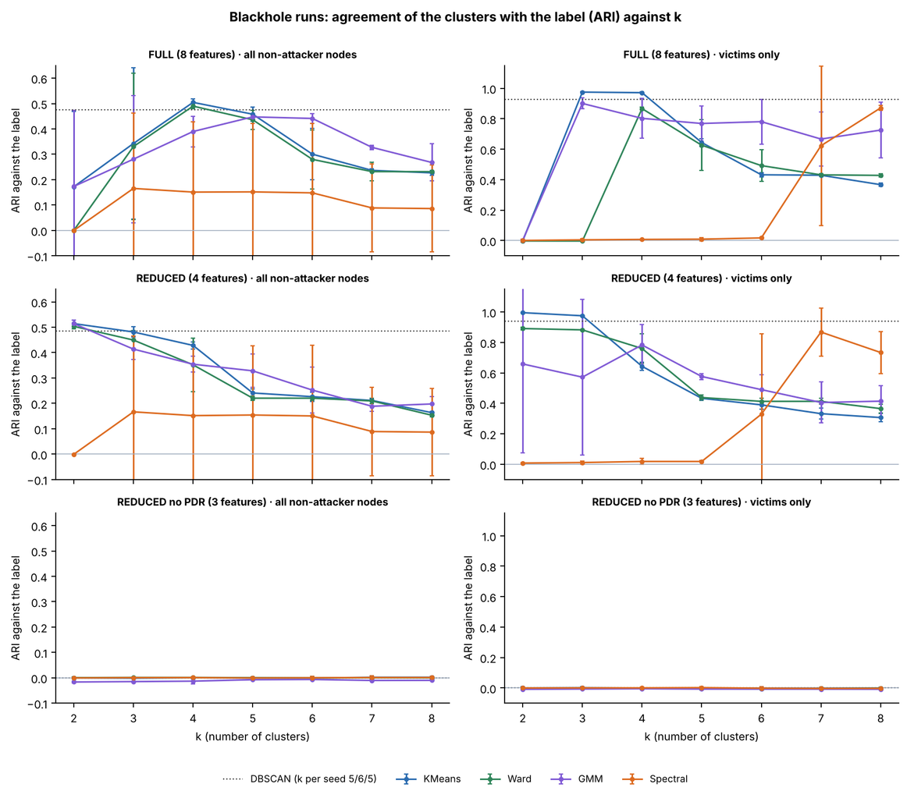
Figure 6.18: agreement with the label against k
How to read it
The question
How well do the clusters match the real attack label, for each number of clusters k?
How to read
Across = k, the number of clusters asked for (2 to 8). Up = ARI: 1 = perfect match, 0 = no better than chance. Rows = feature sets; left = all non-attacker nodes, right = victims only. One line per method (bars = spread over 3 seeds); dotted = DBSCAN, which picks its own k.
What you see
With PDR (top two rows) the methods find the attack. In the bottom row (PDR removed) every line is flat at 0.
Bottom line
K-Means, REDUCED, k = 2: 0.514 on all nodes (0.515 is the best possible) and 0.996 on victims only.
NIS16 | Cross-Layer Dataset of an ESP32 ESP-WIFI-MESH Network | Thesis 3
54
Notes:
KEY FACTS
- Without PDR: ARI -0.016 to 0.002 for every algorithm and every k, on both populations
- Spectral clustering finds the attack on one seed and not on the others (large spread), so it is reported but not relied on
SOURCE: Section 6.4.2, Table 6.25, Figure 6.18
54

Slide 63
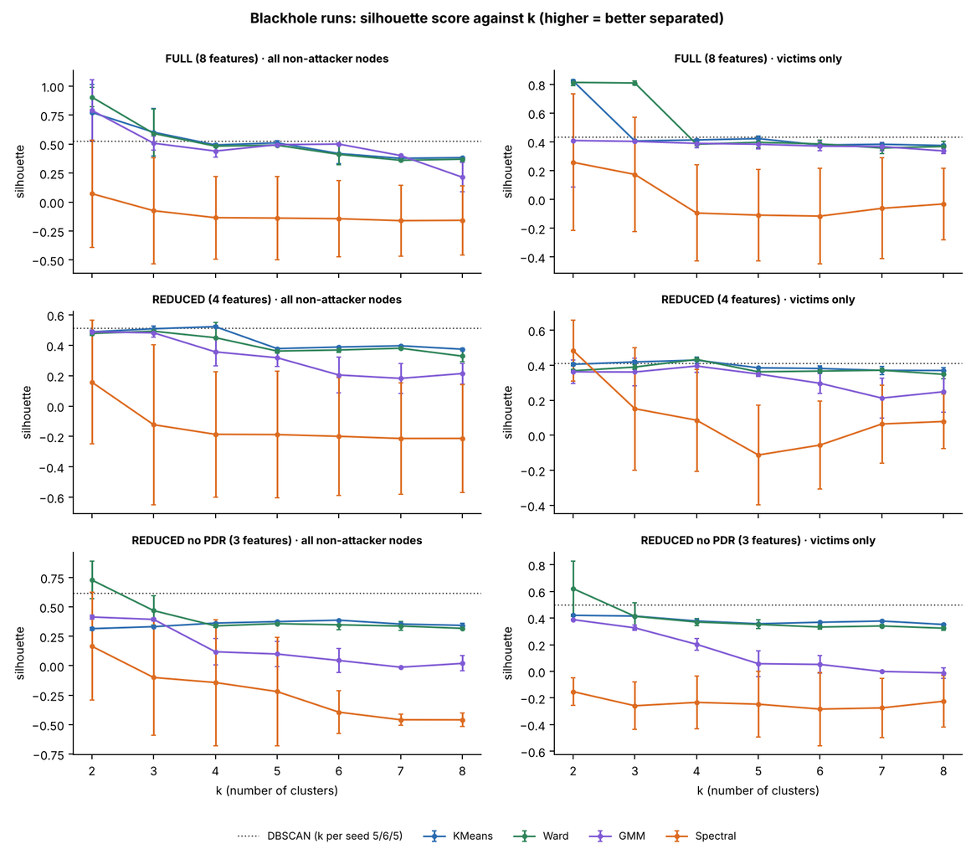
Figure 6.19: silhouette against k
How to read it
The question
Which number of clusters k gives the cleanest-looking groups?
How to read
Same layout as Figure 6.18. Up = silhouette score: near 1 = tight groups far apart, near 0 = groups that blur together. It judges shape only and never looks at the label.
What you see
On FULL (top left), K-Means (0.77) and Ward (0.90) look best at k = 2. But on 2 of the 3 seeds that split only cut off a handful of odd seconds, not the attack.
Bottom line
K-Means ARI at k = 2: only 0.172 (0.515, 0 and 0 over the seeds). The attack appears from k = 4 (0.505). A high silhouette alone can pick the wrong k.
NIS16 | Cross-Layer Dataset of an ESP32 ESP-WIFI-MESH Network | Thesis 3
55
Notes:
KEY FACTS
- Silhouette measures shape, not agreement with the label
- On seed 7 the small cluster was 44 windows of extreme RSSI variance; on seed 123 it was one window where a board changed parent
- The attack is recovered at k = 4 (K-Means 0.505)
SOURCE: Section 6.4.3, Figure 6.19
55

Slide 64
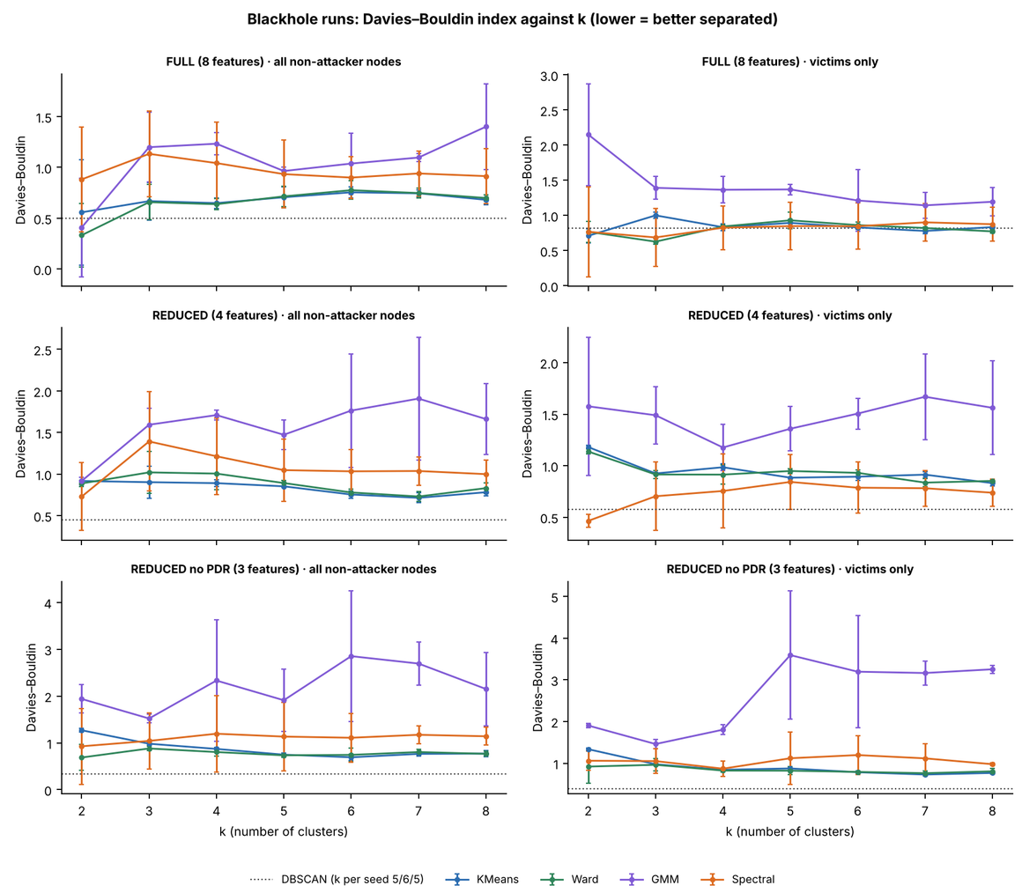
Figure 6.20: Davies–Bouldin index against k
How to read it
The question
A second shape check: which k separates the groups best?
How to read
Same layout as Figure 6.18. Up = Davies–Bouldin index: lower = tighter, better-separated groups (0 is ideal). Like the silhouette, it never looks at the label.
What you see
No single k is best for every method and feature set.
Bottom line
So k was chosen from the elbow, the silhouette and what the clusters mean, together.
NIS16 | Cross-Layer Dataset of an ESP32 ESP-WIFI-MESH Network | Thesis 3
56
Notes:
KEY FACTS
- Chapter 4 planned this combination of criteria; the silhouette alone picked a split that is not the attack
SOURCE: Section 6.4.3, Figure 6.20
56

Slide 65
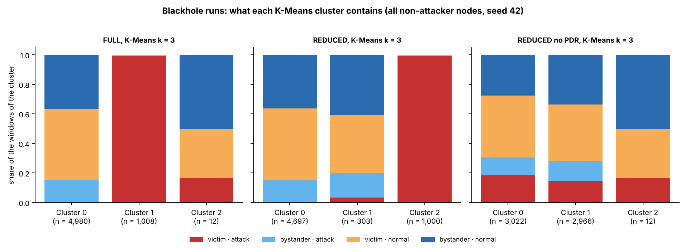
Figure 6.21: what each K-Means cluster contains
How to read it
Question: What is inside each K-Means cluster (k = 3)?
How to read: Each bar = one cluster (n = its size), split by kind of second: red = victim attack, light blue = bystander attack, orange = victim normal, dark blue = bystander normal.
What you see: With PDR (left, middle) one cluster of about 1,000 seconds is almost all red: the victims under attack. Without PDR (right) every cluster is a mix.
NIS16 | Cross-Layer Dataset of an ESP32 ESP-WIFI-MESH Network | Thesis 3
57
Notes:
KEY FACTS
- FULL k = 3: clusters of 4,980, 1,008 and 12 windows; REDUCED: 4,697, 303 and 1,000
- The all-red cluster is the victims under attack, separated by PDR alone
SOURCE: Section 6.4.3, Figure 6.21
57

Slide 66
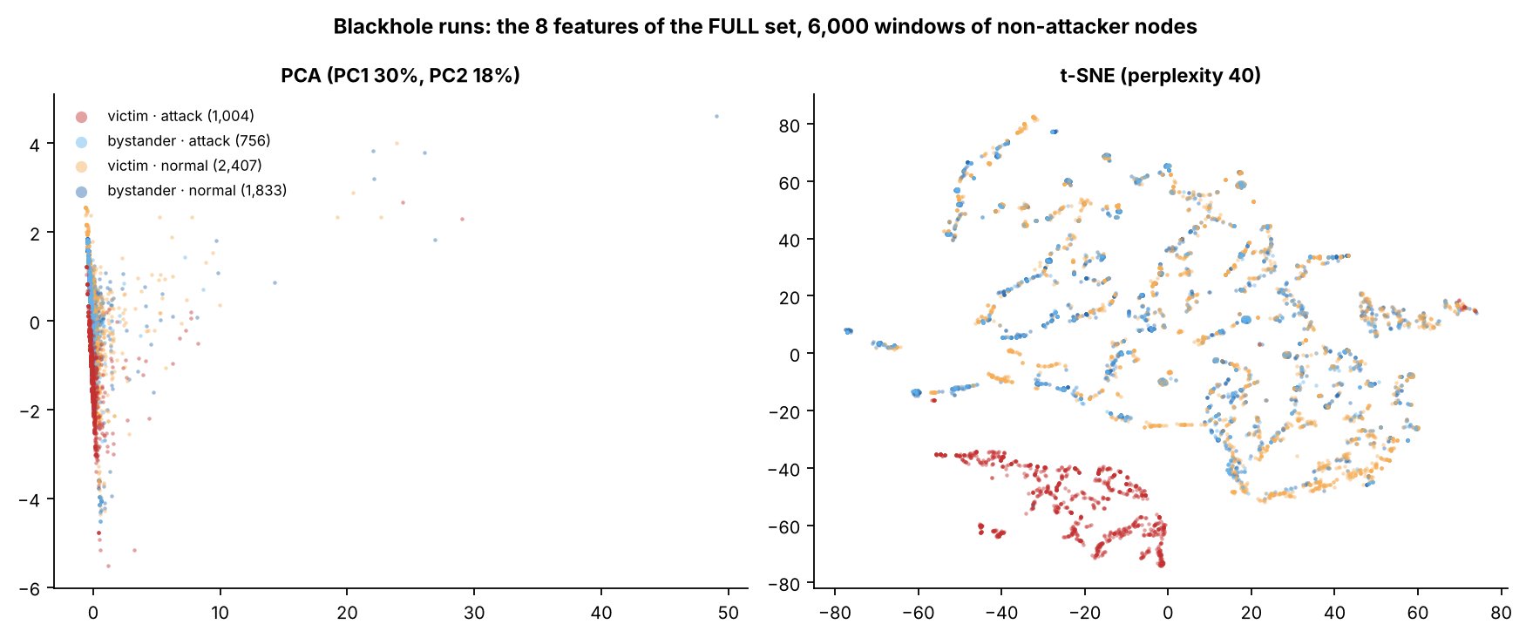
Figure 6.22: PCA and t-SNE, FULL set (blackhole)
How to read it
Question: If we flatten the 8 features into a 2-D picture, do the attack seconds stand apart?
How to read: Each dot = one second of one board. Left: PCA, the two directions with the most spread (30% and 18%). Right: t-SNE, close dots are similar, the axes have no units. Colours as in Figure 6.21.
What you see: In the t-SNE the red dots (victims under attack) form their own island at the bottom. The PCA is squeezed into a thin column by a few seconds with extreme RSSI variance.
NIS16 | Cross-Layer Dataset of an ESP32 ESP-WIFI-MESH Network | Thesis 3
58
Notes:
KEY FACTS
- 6,000 windows of non-attacker nodes; legend counts: victim attack 1,004, bystander attack 756, victim normal 2,407, bystander normal 1,833
SOURCE: Section 6.4.3, Figure 6.22
58

Slide 67
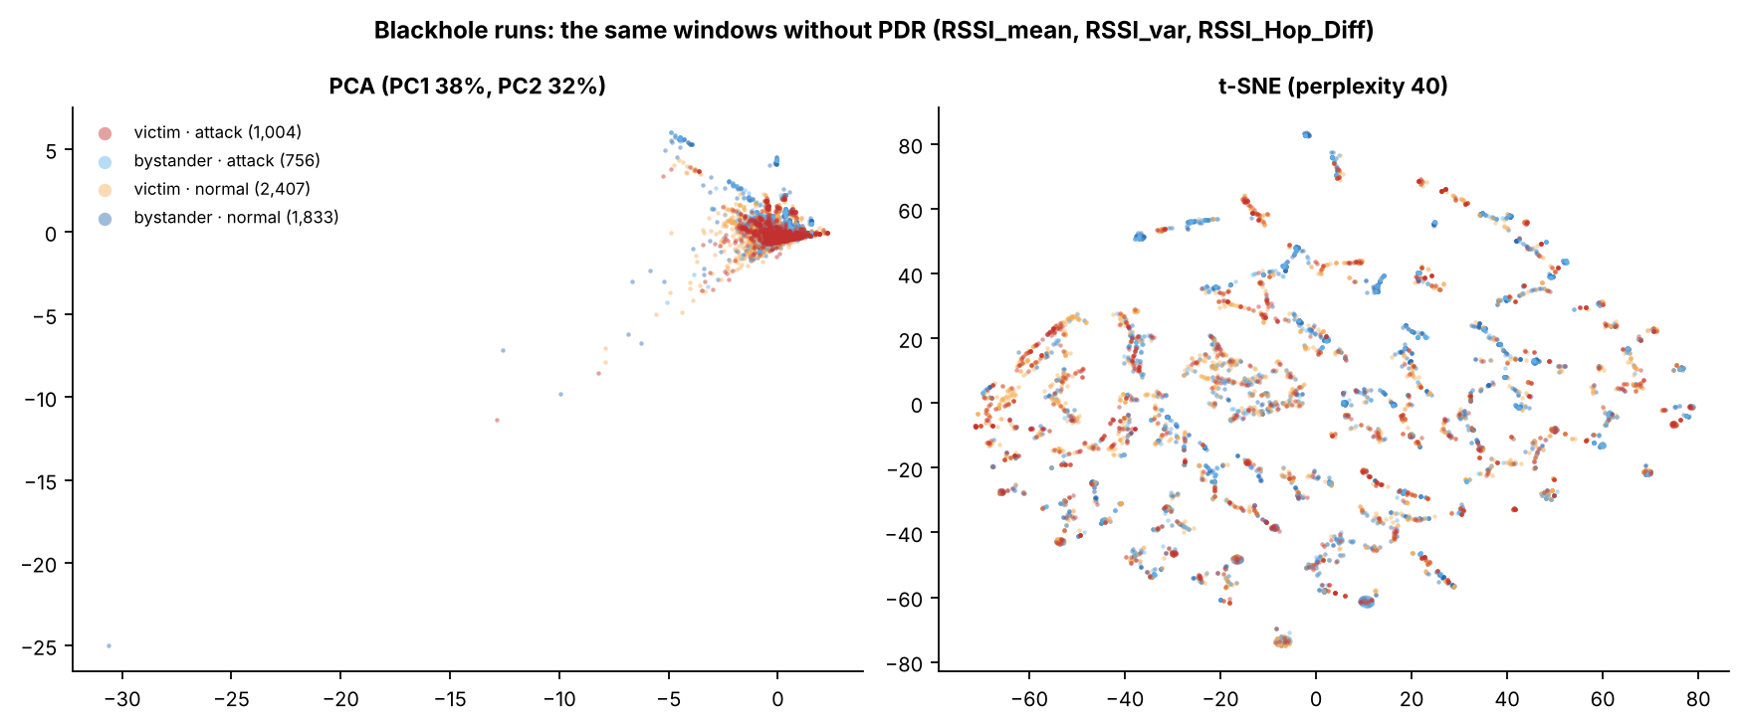
Figure 6.23: the same windows without PDR
How to read it
Question: The same picture with PDR removed: is anything left?
How to read: Only the three RSSI features are used. Left: PCA (38% and 32% of the spread). Right: t-SNE. Same colours as Figure 6.22.
What you see: All four colours lie on top of each other: without PDR there is no attack group to find.
NIS16 | Cross-Layer Dataset of an ESP32 ESP-WIFI-MESH Network | Thesis 3
59
Notes:
KEY FACTS
- Features used: RSSI_mean, RSSI_var, RSSI_Hop_Diff
SOURCE: Section 6.4.3, Figure 6.23
59

Slide 68
Backup B2: wormhole figures
B2
16

Slide 69
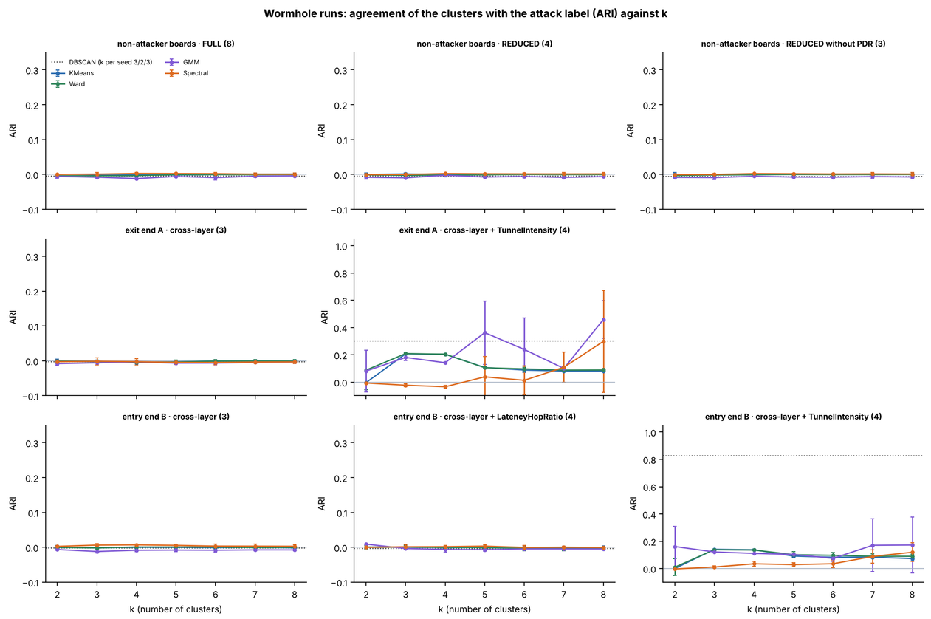
Figure 6.24: wormhole clustering against k
How to read it
The question
Can clustering find the wormhole, and on which boards?
How to read
Each panel = one group of boards and one feature set (number of features in brackets). Across = k; up = ARI (0 = chance, 1 = perfect). Top: non-attacker boards; middle: exit end A; bottom: entry end B. Only the TunnelIntensity panels go up to 1.0.
What you see
Every line is flat at 0 for the non-attacker boards and for the cross-layer features alone. A score appears only once TunnelIntensity, the tunnel's own counter, is added.
Bottom line
DBSCAN on end B with TunnelIntensity: ARI 0.827.
NIS16 | Cross-Layer Dataset of an ESP32 ESP-WIFI-MESH Network | Thesis 3
60
Notes:
KEY FACTS
- TunnelIntensity is excluded from model inputs by the leakage guard; it was added only as a diagnostic
- K-Means k = 2 on B gives ARI 0.000: it splits by signal level (-67.6 vs -47.1 dBm), not by tunnel activity
- Conclusion: the tunnel signal exists, but in the attackers' own counters, not in the cross-layer features
SOURCE: Section 6.4.6, Table 6.28, Figure 6.24
60

Slide 70
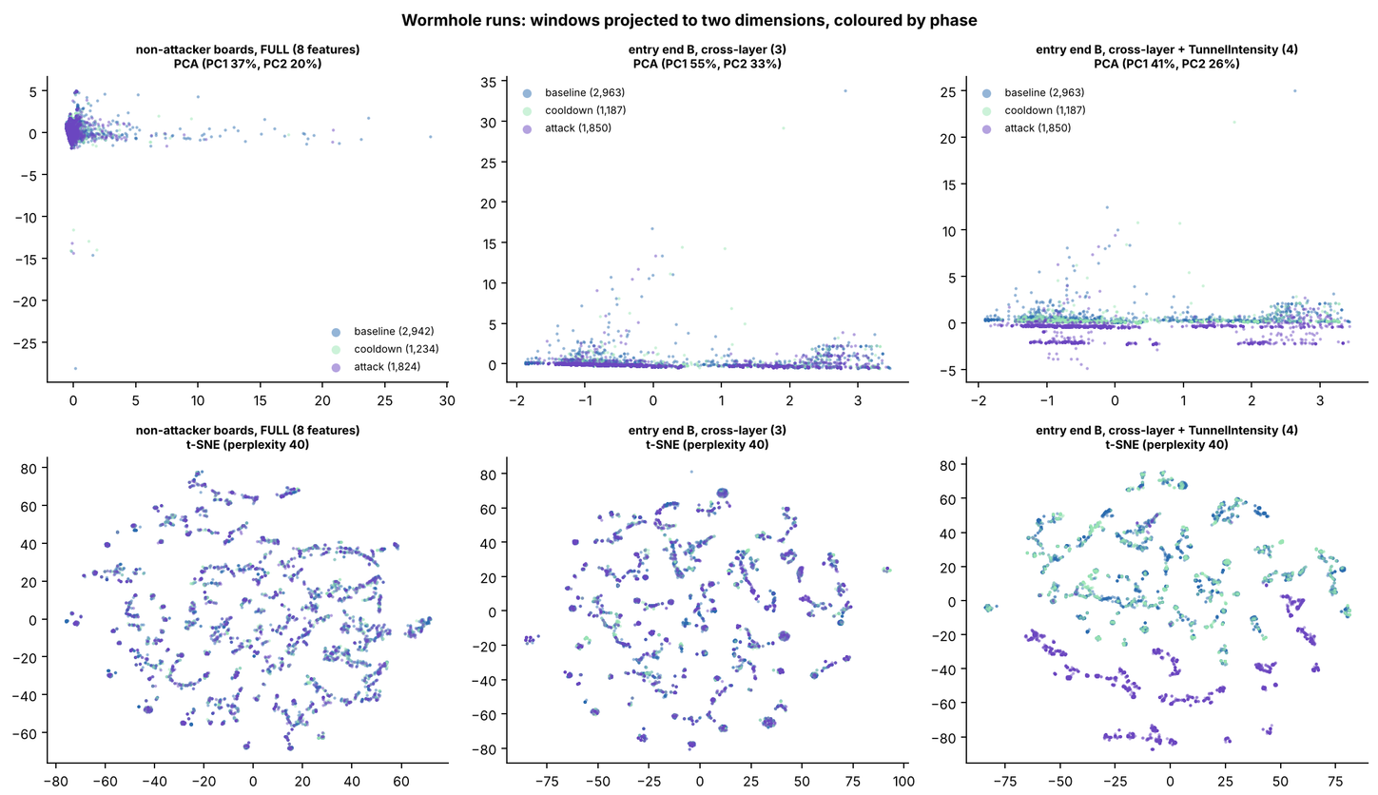
Figure 6.25: PCA and t-SNE of the wormhole runs
How to read it
The question
Do the wormhole attack seconds stand apart in a 2-D picture?
How to read
Top row = PCA, bottom row = t-SNE. Columns: non-attacker boards; end B with cross-layer features; end B with TunnelIntensity added. Purple = attack, blue = baseline, light green = cooldown.
What you see
In the first two columns the colours are fully mixed. Only in the third do the purple dots split off, because TunnelIntensity is 0 in every normal second.
Bottom line
The wormhole shows only in the tunnel's own counter, not in the cross-layer features.
NIS16 | Cross-Layer Dataset of an ESP32 ESP-WIFI-MESH Network | Thesis 3
61
Notes:
KEY FACTS
- The split in the third column comes from a counter the attackers keep themselves, not from the radio or routing features
SOURCE: Section 6.4.6, Figure 6.25
61

Slide 71
Backup B3: shared figures
B3
16

Slide 72
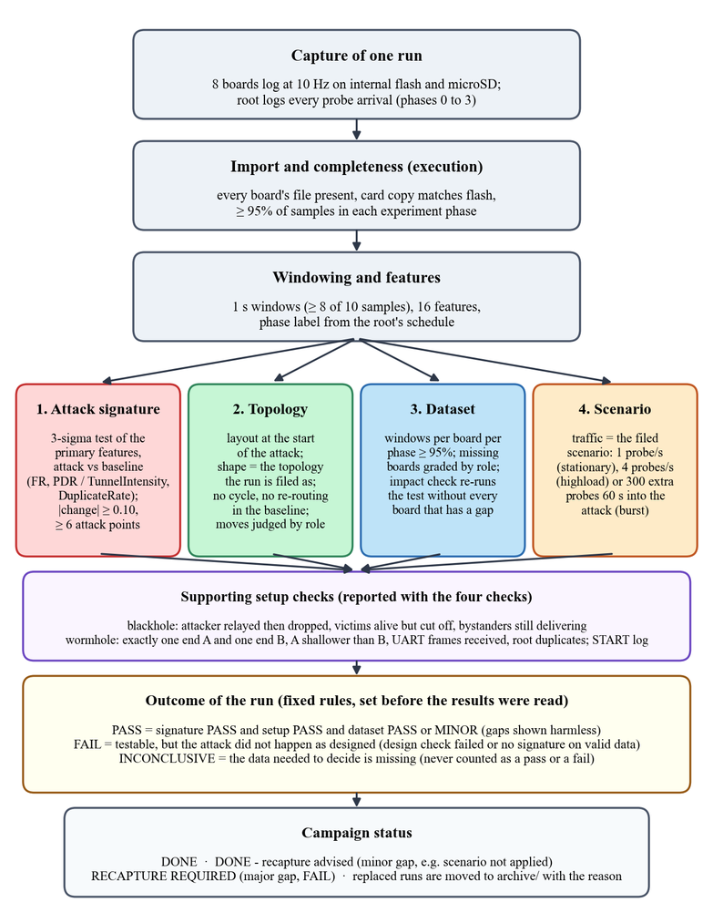
Figure 4.55: the order of the verifier's checks
How to read it
The question
In what order does the verifier check a run before it enters the dataset?
How to read
A flowchart, read top to bottom. Grey boxes: capture, import, features. Then four checks side by side: red = attack signature, green = topology, blue = dataset, orange = scenario. Purple = setup checks; yellow = how the outcome is decided.
What you see
Every run goes through the same path, and the outcome rules were fixed before any result was read.
Bottom line
Three outcomes: PASS, FAIL or INCONCLUSIVE. Missing data is never counted as a pass or a fail.
NIS16 | Cross-Layer Dataset of an ESP32 ESP-WIFI-MESH Network | Thesis 3
41
Notes:
KEY FACTS
- The four checks run on the same windows
- Setup check confirms the roles: blackhole attacker relayed then dropped and victims are alive but cut off; wormhole has one A and one B, A shallower, and the wire delivered B's frames
- Missing data never becomes a pass or a fail
- Decision: keep, or archive and recapture
SOURCE: Section 4.2.7, Figure 4.55, Table 4.24
41

Slide 73
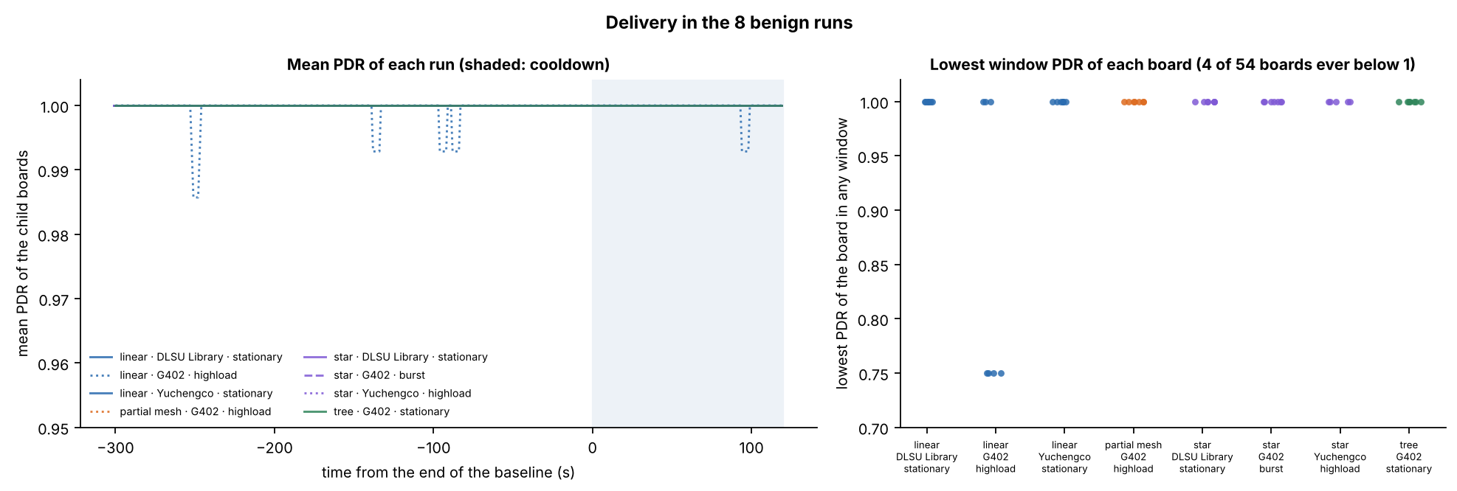
Figure 6.13: delivery in the 8 benign runs
How to read it
Question: Did delivery stay healthy in the 8 runs without any attack?
How to read: Left: each run's average PDR over time (0 = end of baseline, shaded = cooldown); the axis starts at 0.95 so tiny dips show. Right: each dot = one board's worst second.
What you see: All runs stay at 1.00 apart from small dips in one run. Only 4 of 54 boards ever dropped below 1, all in linear / G402 / highload (lowest 0.75).
NIS16 | Cross-Layer Dataset of an ESP32 ESP-WIFI-MESH Network | Thesis 3
50
Notes:
KEY FACTS
- Mean PDR per benign run 0.9994 to 1.0000
- Left axis starts at 0.95, so the dips look larger than they are
SOURCE: Sections 6.2.6 and 6.3.3, Figure 6.13
50

Slide 74
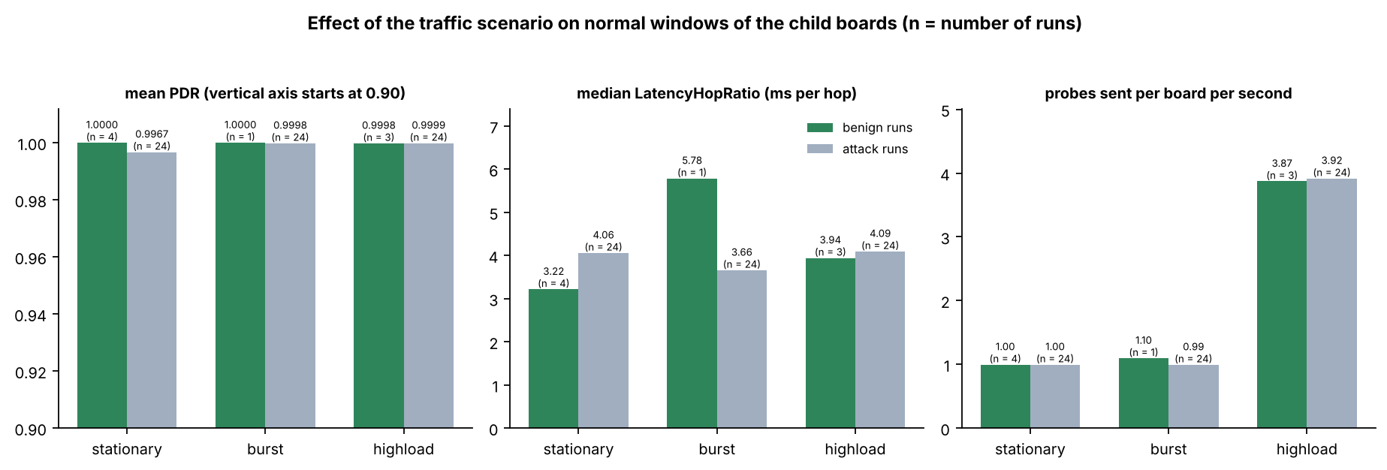
Figure 6.14: effect of the traffic scenario
How to read it
Question: Does each traffic scenario behave the same in benign and attack runs?
How to read: Three panels: average PDR (axis starts at 0.90), typical delay per hop (ms), probes sent per board per second. Green = benign runs, grey = normal seconds of attack runs; n above a bar = runs.
What you see: Probe rate and PDR match, so a scenario means the same in both kinds of run (highload = about 4 probes/s). Delay per hop differs most in burst, which has only 1 benign run.
NIS16 | Cross-Layer Dataset of an ESP32 ESP-WIFI-MESH Network | Thesis 3
51
Notes:
KEY FACTS
- The PDR axis starts at 0.90, so a gap such as 1.0000 vs 0.9967 looks bigger than it is
- Probe rates about 1.0, 1.1 and 3.9 per board per second
SOURCE: Section 6.3.3, Figure 6.14
51

Slide 75
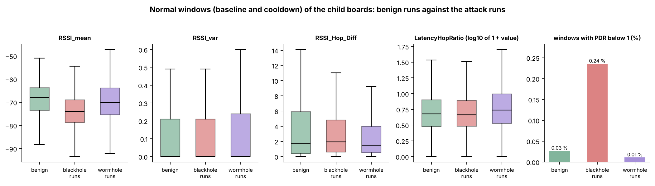
Figure 6.15: normal windows, benign vs. attack runs
How to read it
Question: Are the normal seconds of benign runs like the normal seconds of attack runs?
How to read: One panel per feature, baseline and cooldown only: green = benign runs, red = blackhole runs, purple = wormhole runs. Box = middle half. Last panel = % of seconds with PDR below 1.
What you see: Only RSSI_mean differs clearly (the blackhole runs are lower). That comes from the set-up of each capture, not from an attack (see Figure 6.16).
NIS16 | Cross-Layer Dataset of an ESP32 ESP-WIFI-MESH Network | Thesis 3
52
Notes:
KEY FACTS
- Normal windows = baseline and cooldown of the child boards
- Windows with PDR below 1: 0.03% benign, 0.24% blackhole runs, 0.01% wormhole runs
SOURCE: Section 6.3.3, Tables 6.22 and 6.23, Figure 6.15
52

Slide 76
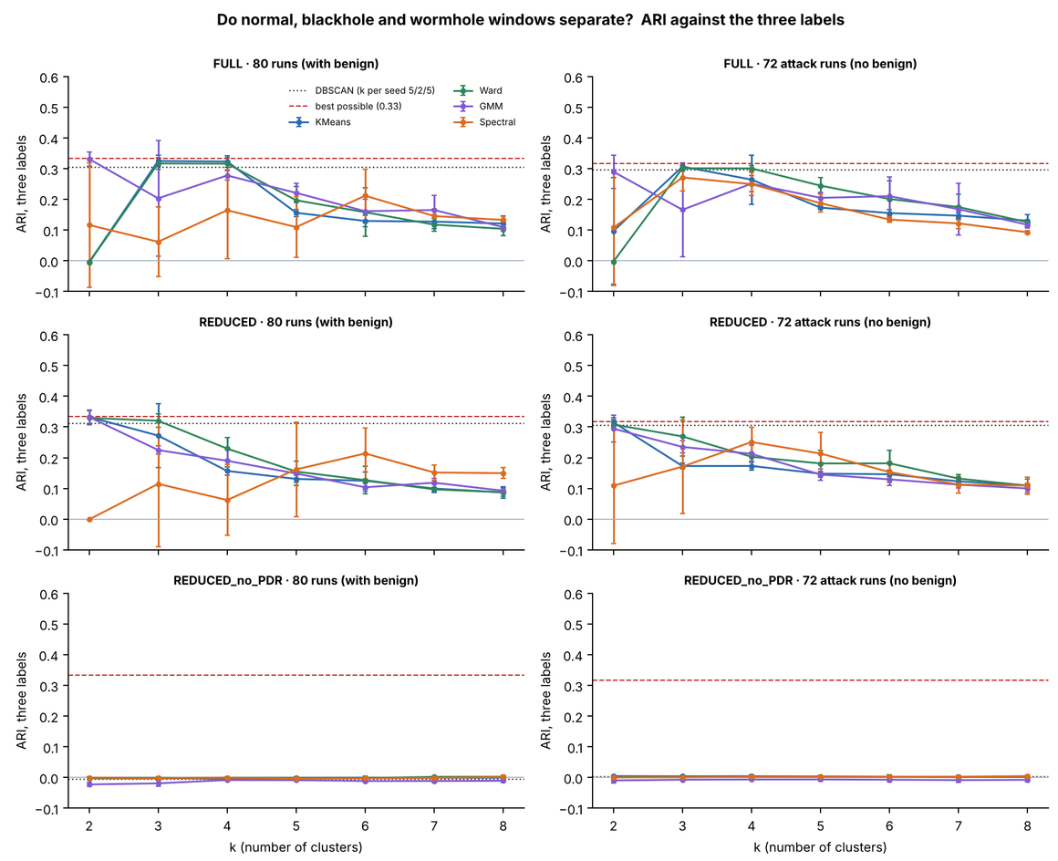
Figure 6.26: normal, blackhole and wormhole windows
How to read it
The question
Can clustering tell normal, blackhole and wormhole seconds apart when all runs are pooled?
How to read
Across = k; up = ARI against the three labels. Rows = feature sets; left = all 80 runs, right = the 72 attack runs. Red dashed = the best possible score (0.33 and 0.32): finding exactly the victim seconds and nothing else.
What you see
K-Means reaches the red line (k = 2 on REDUCED, k = 3 on FULL) but never passes it, so the wormhole seconds are never found. Without PDR every line is at 0.
Bottom line
REDUCED, 80 runs: K-Means 0.333, best possible 0.334.
NIS16 | Cross-Layer Dataset of an ESP32 ESP-WIFI-MESH Network | Thesis 3
62
Notes:
KEY FACTS
- Best possible = victim attack windows vs. everything else: 0.334 (80 runs), 0.317 (72 attack runs), on the 6,000-window samples
- K-Means finds the blackhole victims and nothing else; the wormhole is not detected by the non-attacker features
SOURCE: Section 6.4.7, Table 6.32, Figure 6.26
62

Slide 77
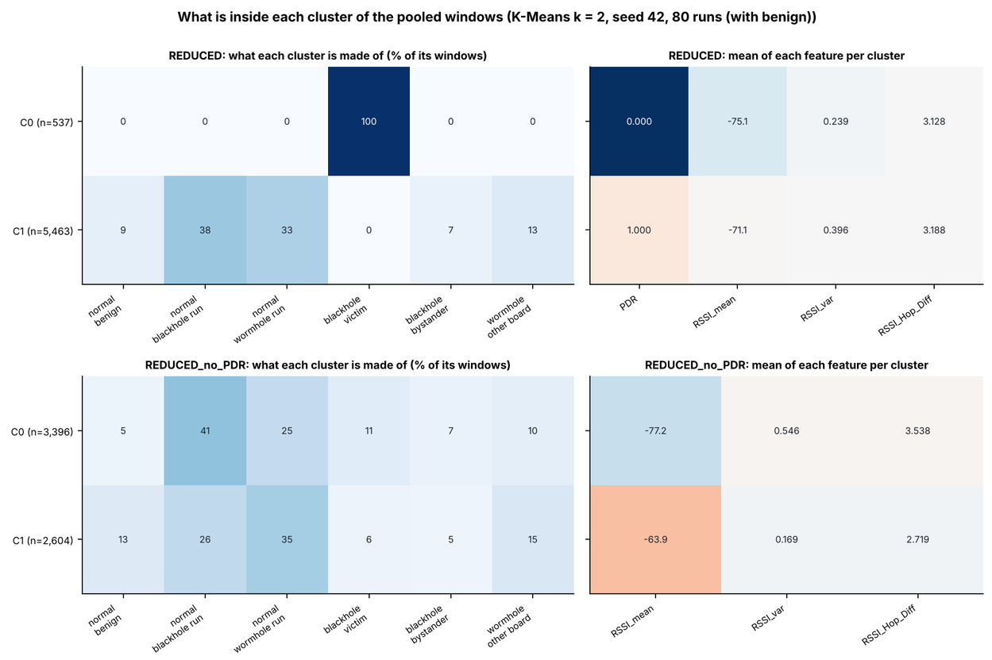
Figure 6.27: pooled clusters, K-Means k = 2
How to read it
The question
What is inside the two K-Means clusters of the pooled 80 runs?
How to read
Each row = a cluster (n = size). Left tiles: % of the cluster from each kind of second (darker = more). Right tiles: the cluster's average of each feature. Top = REDUCED, bottom = REDUCED without PDR.
What you see
Top: cluster C0 (537 seconds) is 100% blackhole victims, with PDR 0.000. Bottom: without PDR both clusters mix all six kinds and differ only in signal level (−77.2 vs. −63.9 dBm).
Bottom line
No benign second falls in the victim cluster: it picks up the delivery collapse, not the traffic.
NIS16 | Cross-Layer Dataset of an ESP32 ESP-WIFI-MESH Network | Thesis 3
63
Notes:
KEY FACTS
- Groups: normal benign, normal blackhole run, normal wormhole run, blackhole victim, blackhole bystander, wormhole other board
- Pooled set: non-attacker boards of all 80 runs, 257,258 windows
SOURCE: Section 6.4.7, Figure 6.27
63

Slide 78
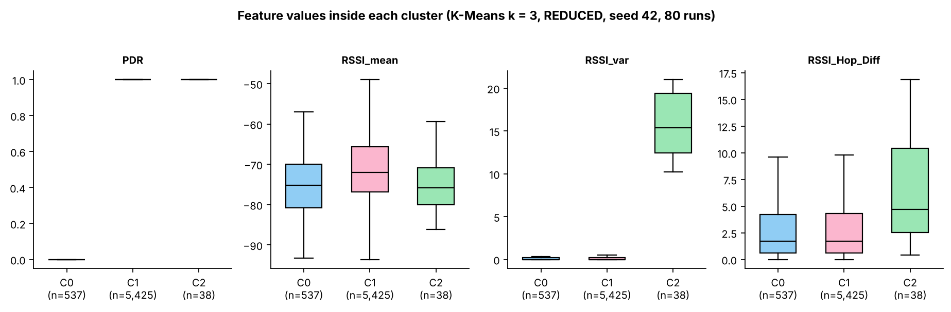
Figure 6.29: feature values inside each cluster
How to read it
Question: What makes each of the three pooled clusters different?
How to read: One panel per feature; one box per cluster (k = 3, REDUCED set) with its size. Blue = C0, pink = C1, green = C2. Box = middle half.
What you see: C0 is defined by PDR = 0 (the victims). C2 is a small group (38 seconds) with very high RSSI variance: noisy seconds, not an attack. The other features overlap.
NIS16 | Cross-Layer Dataset of an ESP32 ESP-WIFI-MESH Network | Thesis 3
64
Notes:
KEY FACTS
- n = 537, 5,425 and 38 windows
- C2 mixes every group (no victims), so it is a signal-variance outlier group
SOURCE: Section 6.4.7, Figure 6.29
64

